Slide 1
Transformations
Notes:
See text videos and load some examples on here.

Slide 2
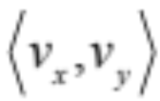


This is a Vector
It appears as a line segment that connects two points
and it is expressed like this:
It also has something else:
Direction
But the best part is
it’s really just the hypotenuse of a right triangle
What are those symbols inside the chevrons?
They are the x and y coordinates of the vector.

Slide 3
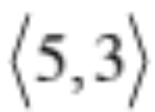


This is a Vector
It appears as a line segment that connects two points
Vectors in a Plane
This is not the same as the point (5, 3)
This refers to a horizontal displacement of 5
and a vertical displacement of 3
Now let’s take a look at this on a graph

Slide 4
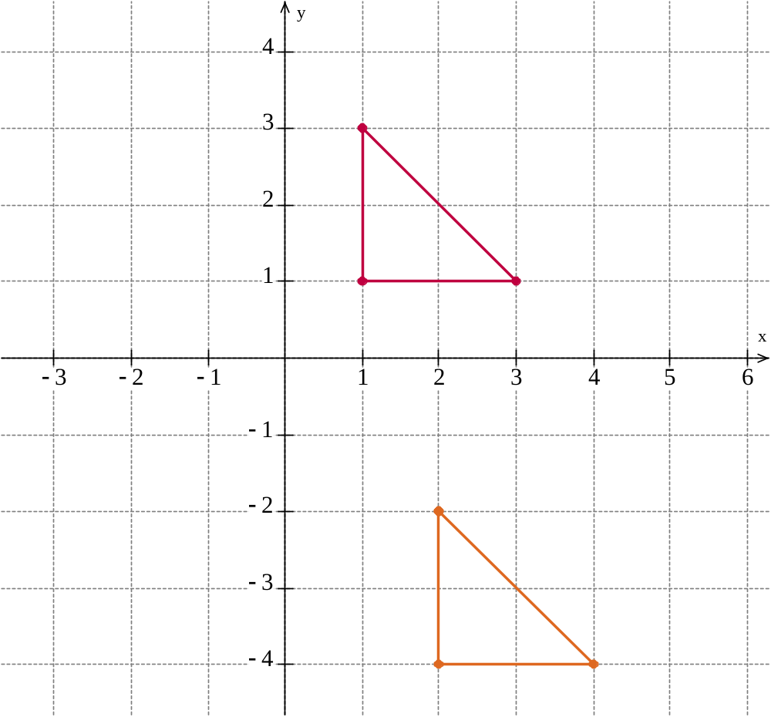
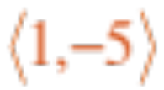
Translation
- Moving the graph across and/or down the xy plane
Your book will call it a rigid motion
(x, y) → (x + 1, y – 5)
Translate the given triangle along the vector
(1, 3)
By how much are the x and y coordinates changed here?
(3, 1)
(1, 1)
A composition consists of two or more rigid motions
(2, –2)
(4, –4)
(2, –4)

Slide 5
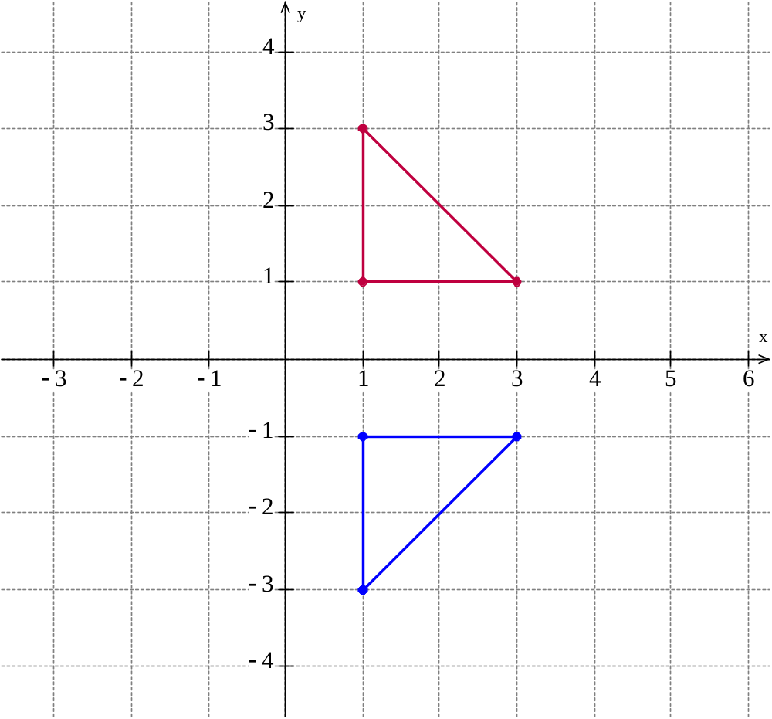
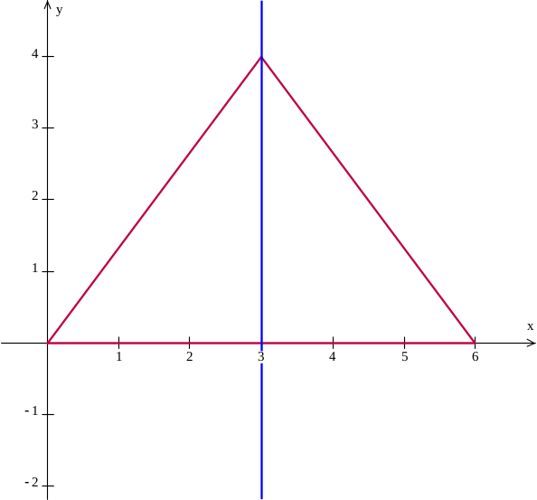
Reflection across the x-axis
(x, y) → (x, –y)
Note that the x-axis here is the axis of symmetry.
(1, 3)
The axis of symmetry acts as a reflector that bisects the combined figure.
Example: x = 3 is the axis of symmetry for the isosceles triangle
(3, 1)
(1, 1)
(1, –1)
(3, –1)
(1, –3)

Slide 6
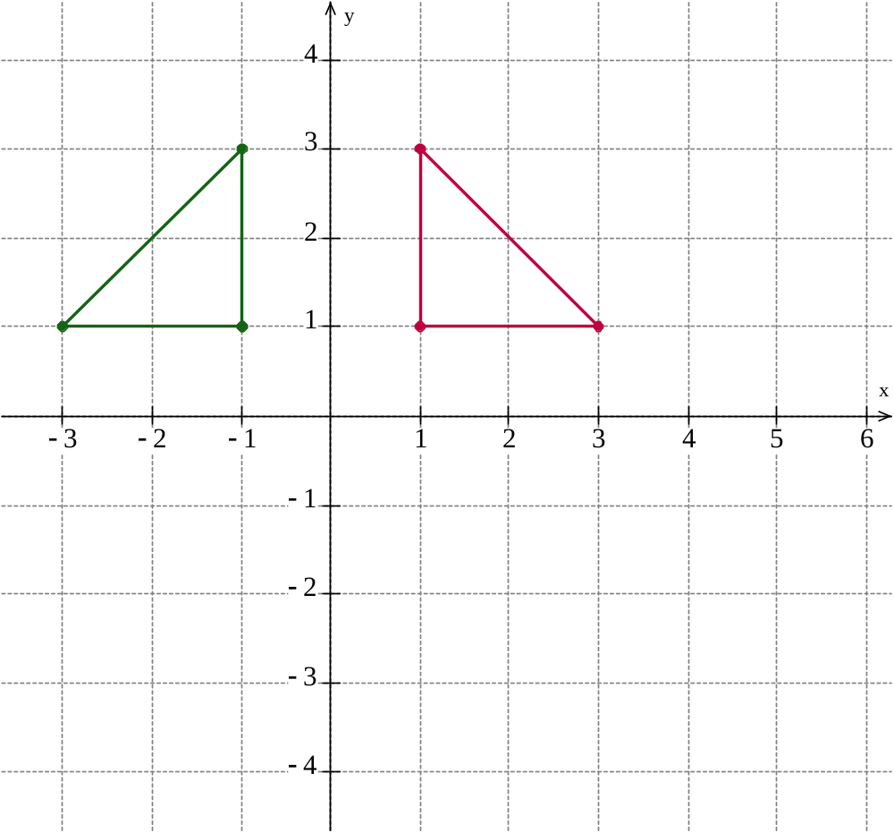
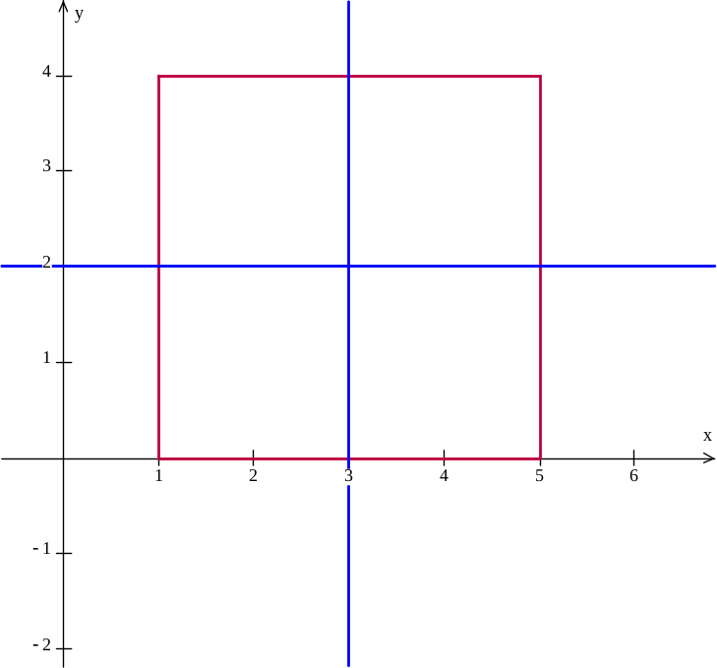
Reflection across the y-axis
(x, y) → (–x, y)
Note that the y-axis here is the axis of symmetry.
(–1, 3)
(1, 3)
The axis of symmetry acts as a reflector that bisects the combined figure.
Example: both the lines x = 3 and y = 2 are axes of symmetry for the square
(–3, 1)
(3, 1)
(–1, 1)
(1, 1)

Slide 7
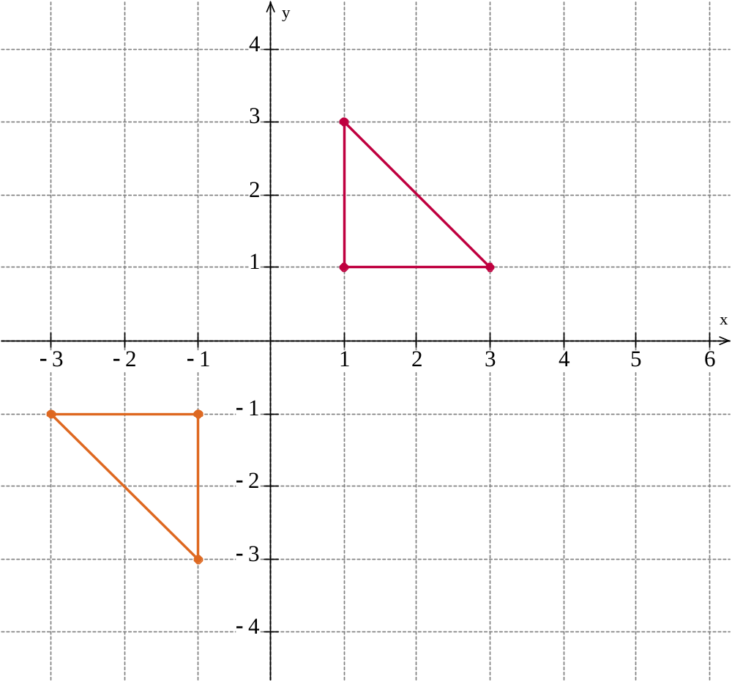
Reflection across the origin
(x, y) → (–x, –y)
(1, 3)
(3, 1)
(1, 1)
(–1, –1)
(–3, –1)
(–1, –3)

Slide 8
Reflection across the origin
(x, y) → (–x, –y)
(1, 3)
(3, 1)
(1, 1)
(–1, –1)
(–3, –1)
(–1, –3)

Slide 9
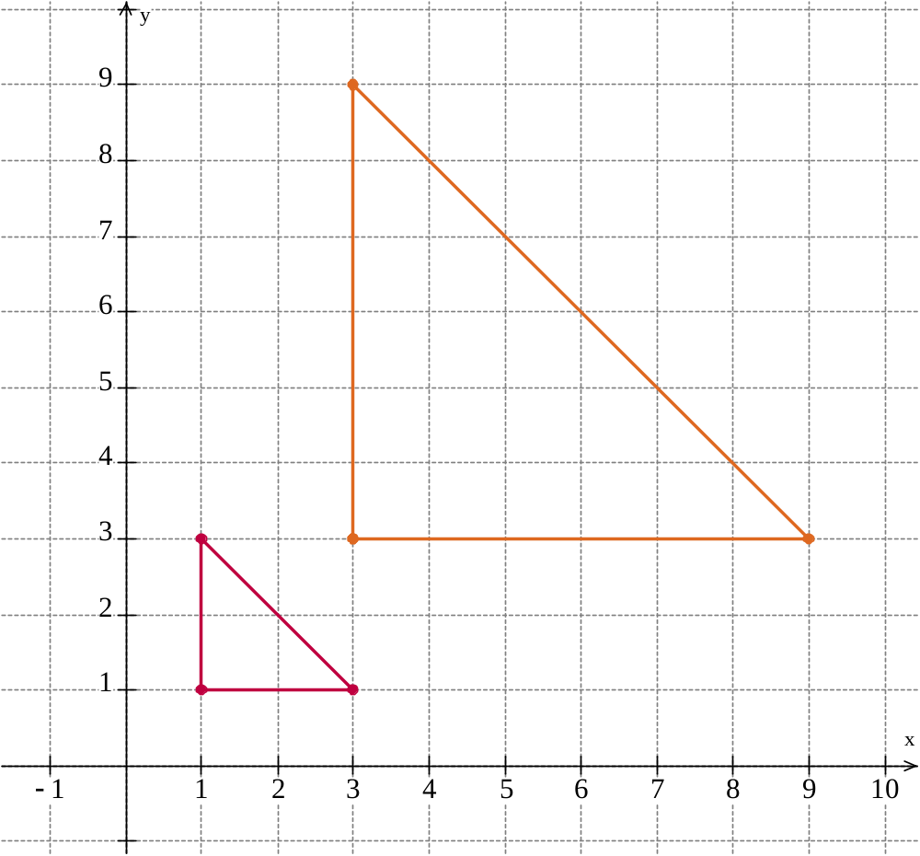
Dilation
- Increasing the size by a given scale factor
(x, y) → (3x, 3y)
(3, 9)
By how much are the x and y coordinates changed here?
(1, 3)
(3, 3)
(9, 3)
(3, 1)
(1, 1)

Slide 10
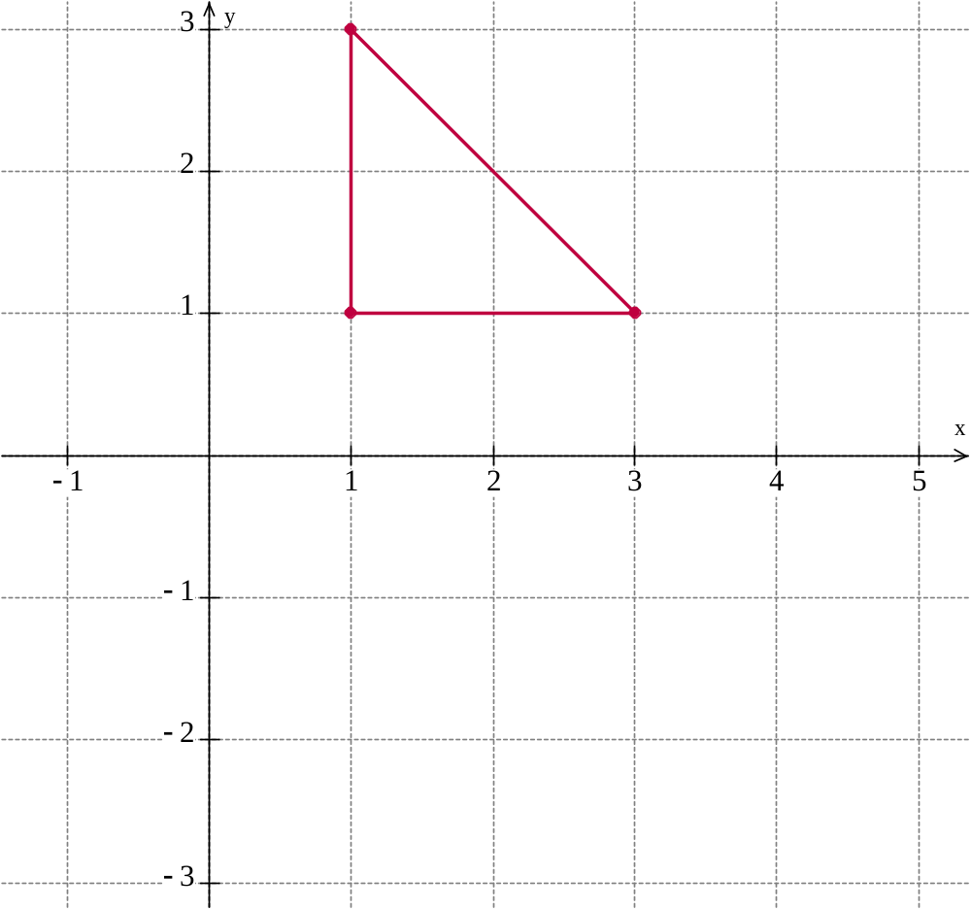
Rotation
- Rotating the x and y coordinates so that the figure is
rotated
(x, y) → (–y, x)
(1, 3)
Here is a 90 degree rotation to the right about the origin
(1, 1)
(3, 1)

Slide 11
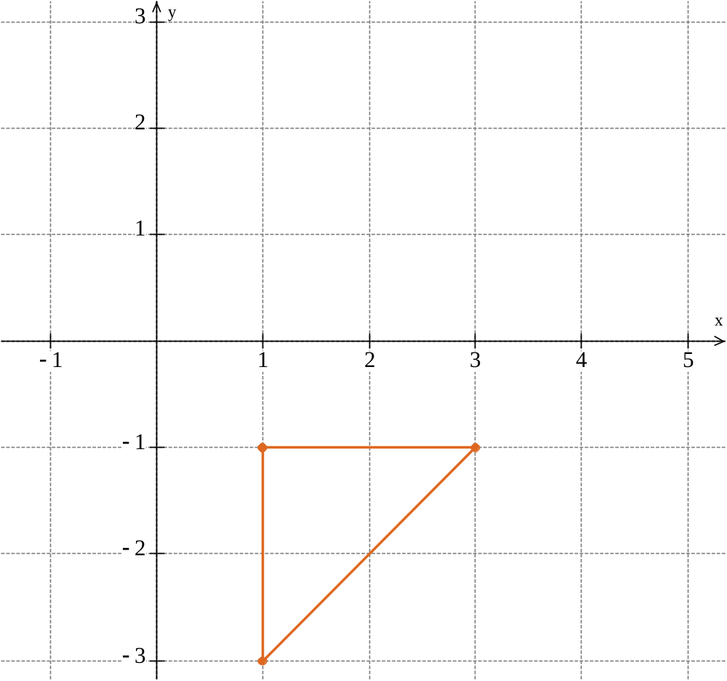
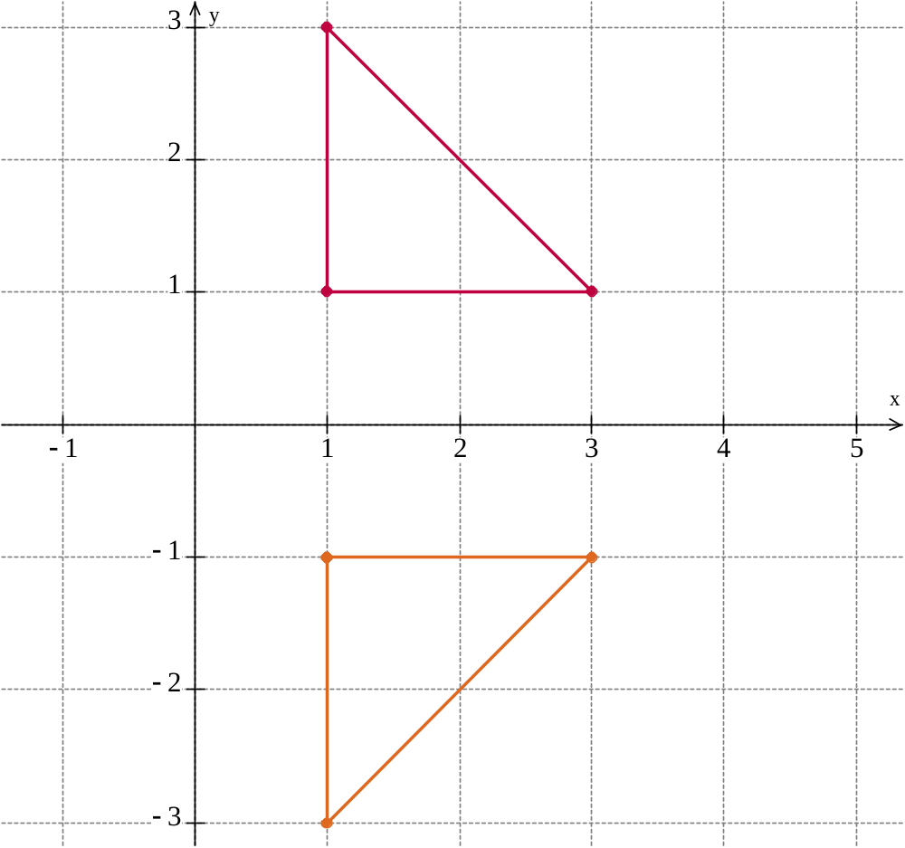
Rotation
- Rotating the x and y coordinates so that the figure is
rotated
(x, y) → (–y, x)
(1, 3)
Here is a 90 degree rotation to the right about the origin
(1, 1)
(3, 1)
(–1, 1)
(3, –1)
(1, –3)

