Slide 1
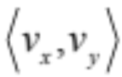


This is a Vector
It appears as a line segment that connects two points
8-6 Vectors in a Plane
It also has something else:
Direction
But the best part is
it’s really just the hypotenuse of a right triangle
What are those symbols next to each line segment?
We shall soon see.
Greg Kelly, Hanford High School, Richland, Washington

Slide 2
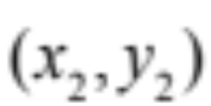
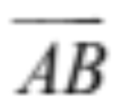
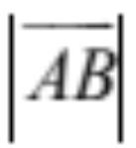

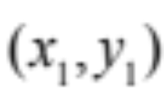

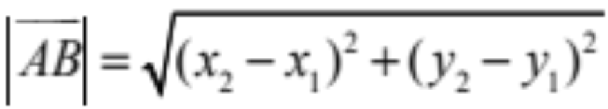
In the past we’ve only worked with lines that have slopes but not necessarily direction.
Quantities such as force, displacement or velocity that have direction as well as magnitude are represented by directed line segments.
There’s a difference between going 50 mph north and 50 mph south
The length is of this vector is written as
terminal
point
B
It can be calculated like this:
A
initial
point
Look, it’s just the distance formula

Slide 3
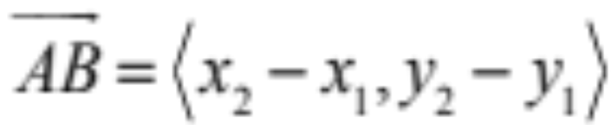
In the past we’ve only worked with lines that have slopes but not necessarily direction.
Quantities such as force, displacement or velocity that have direction as well as magnitude are represented by directed line segments.
There’s a difference between going 50 mph north and 50 mph south
terminal
point
The component form of this vector is:
B
The horizontal change in position
A
initial
point
The vertical change in position

Slide 4
In the past we’ve only worked with lines that have slopes but not necessarily direction.
Quantities such as force, displacement or velocity that have direction as well as magnitude are represented by directed line segments.
There’s a difference between going 50 mph north and 50 mph south
terminal
point
The component form of this vector is:
B
A
initial
point
Notice here that we always subtract the initial point from the terminal point because we need to establish direction

Slide 5
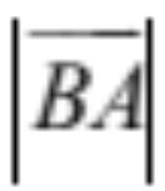
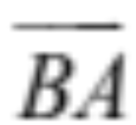
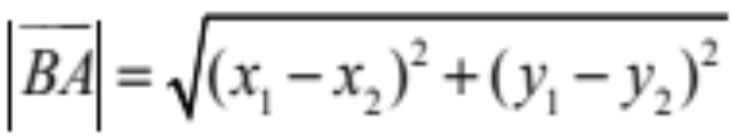
In the past we’ve only worked with lines that have slopes but not necessarily direction.
Quantities such as force, displacement or velocity that have direction as well as magnitude are represented by directed line segments.
There’s a difference between going 50 mph north and 50 mph south
B
The length is written as
initial
point
A
terminal
point
Notice that the length will be the same

Slide 6
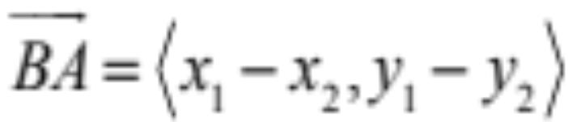
In the past we’ve only worked with lines that have slopes but not necessarily direction.
Quantities such as force, displacement or velocity that have direction as well as magnitude are represented by directed line segments.
There’s a difference between going 50 mph north and 50 mph south
The component form of this vector is:
B
initial
point
A
terminal
point
Same vector length (magnitude), same slope (line segment) but opposite vectors.

Slide 7
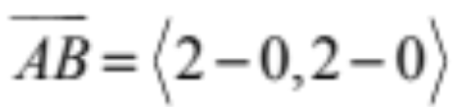
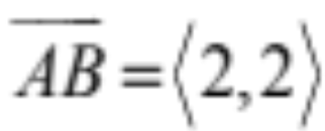
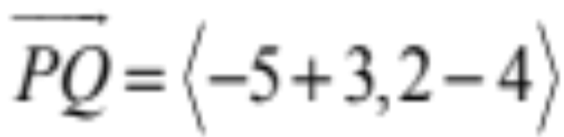
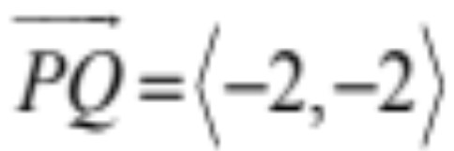
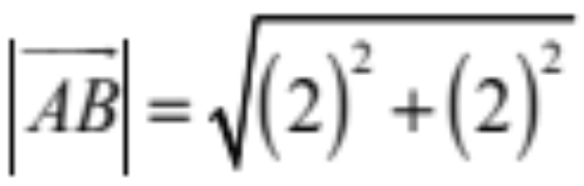
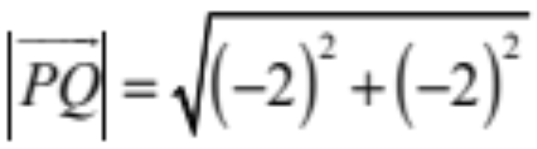
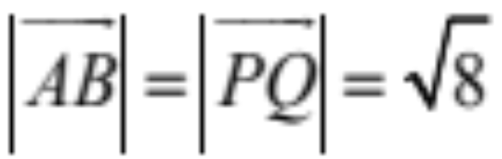
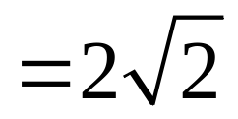
Find the component form of each vector
(–3, 4)
P
(2, 2)
B
(–5, 2)
Q
A

Slide 8

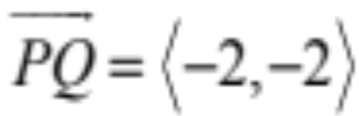
Find the component form of each vector
(–3, 4)
P
(2, 2)
B
(–5, 2)
Q
A
Notice that the vectors are pointed in opposite directions
but have the same length.

Slide 9
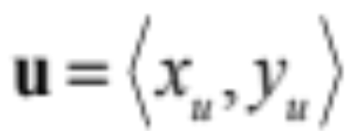
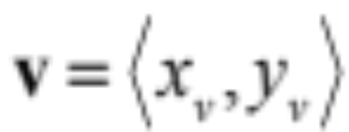
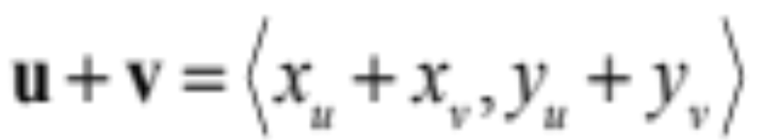
x_{u}+ x_{v}
Vector Addition:
v
y_{v}
u + v
y_{u} + y_{v}
x_{v}
u + v
u + v is the resultant vector.
y_{u}
u
x_{u}
(Add the components.)
Notes:
Clean this up and add examples

Slide 10
One method of adding vectors is the
Head to Tail Method
Vector Addition:
v
u + v
u + v
u + v is the resultant vector.
u
(Add the components.)
Notes:
Clean this up and add examples

Slide 11
Vector Addition:
u
v
u + v
u + v
u + v is the resultant vector.
v
u
This one is called the
Parallelogram Method
(Add the components.)
Notes:
Clean this up and add examples

Slide 12
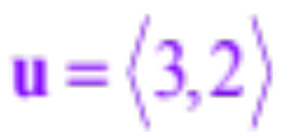
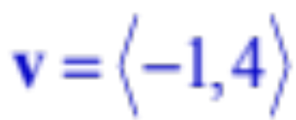
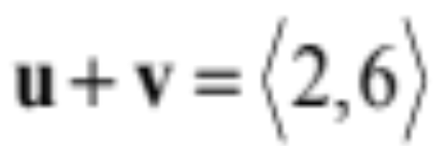
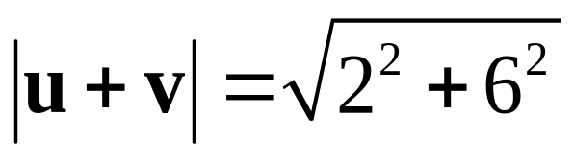
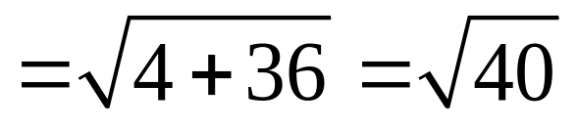
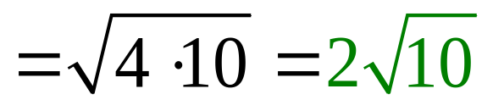
3 – 1
Vector Addition:
u + v
v
u + v is the resultant vector.
2 + 4
4
–1
u + v
2
u
3
See? Just add the components
By the way, what’s the length of this new vector?
Notes:
Clean this up and add examples

Slide 13



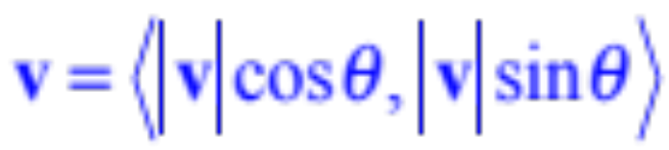
y
Now let’s use trig ratios to break vectors into components.
x
What if we only knew the length of the vector and the angle?
The component form of this vector is:
Before anyone panics, this is just SOHCAHTOA…
Just watch…

Slide 14
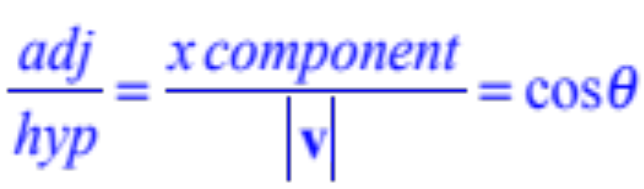
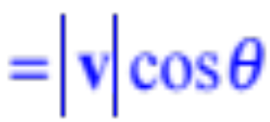
y
A vector is in standard position if the initial point is at the origin.
x
x component
x component
x component
Remember what this really means:
Think of it as a hypotenuse of the right triangle above because it’s the length of the vector
x component

Slide 15
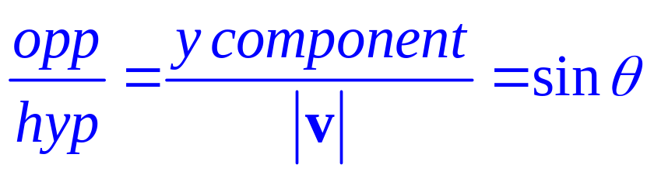
y
A vector is in standard position if the initial point is at the origin.
y component
x
y component
x component
y component
See? Just SOHCAHTOA
Remember what this really means:
Remember that the length of the vector is just the hypotenuse of the right triangle above.
x component
y component

Slide 16
This is a Vector
It appears as a line segment that connects two points
8-6 Vectors in a Plane
It also has something else:
Direction
But the best part is
it’s really just the hypotenuse of a right triangle
Greg Kelly, Hanford High School, Richland, Washington

