Slide 1
12.5
Angle Relationships within Circles

Slide 2
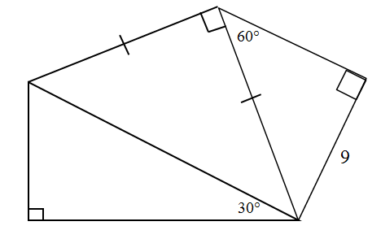



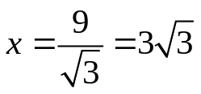
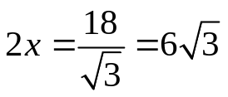













Slide 3

Given the regular hexagon of side length 10, find the lengths of all the interior diagonals
10
Now before anyone panics…
Notes:
Make sure all vertices and connectors are lined up better

Slide 4

Given the regular hexagon of side length 10, find the lengths of all the interior diagonals
These are all congruent triangles.
10
They are also something else…
equilateral
Since the triangles all have sides of length 10…
for each diagonal
Notes:
Make sure all vertices and connectors are lined up better

Slide 5
Given the regular hexagon of side length 10, find the lengths of all the interior diagonals
These diagonals also form one big equilateral triangle so if we find one length we’ve found the other two..
10
Notes:
Make sure all vertices and connectors are lined up better

Slide 6

Given the regular hexagon of side length 10, find the lengths of all the interior diagonals
What can we say about this triangle?
10
It’s isosceles and…
…it’s altitude bisects it into two right triangles.
In this case they are both 30-60-90 triangles.
So let’s find the side lengths using this ratio.
Notes:
Make sure all vertices and connectors are lined up better

Slide 7
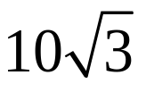
Given the regular hexagon of side length 10, find the lengths of all the interior diagonals
So the lengths of these diagonals are…
for each diagonal
for each diagonal
Notes:
Make sure all vertices and connectors are lined up better

Slide 8
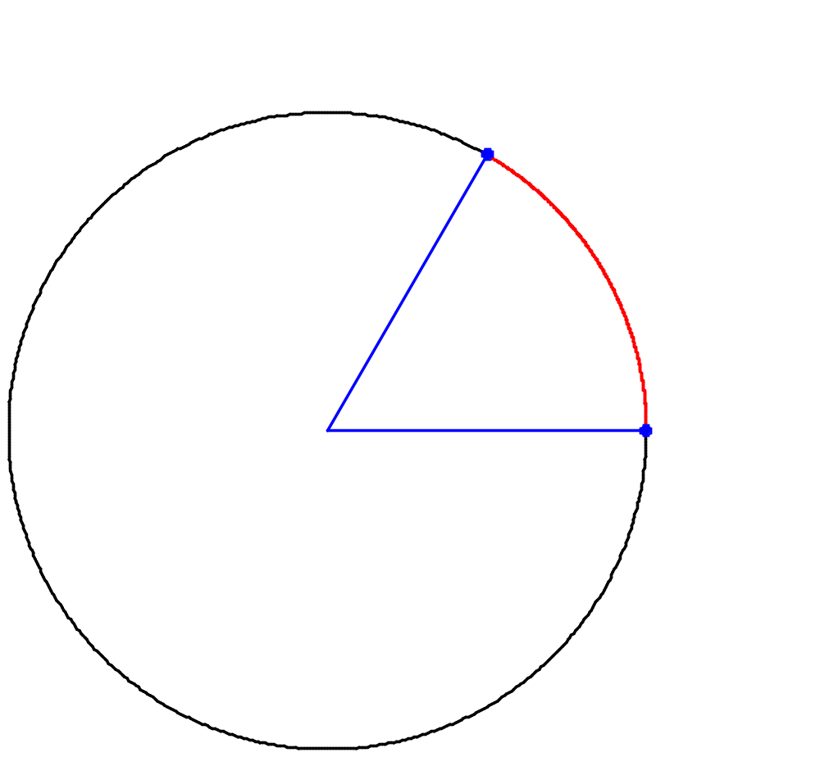




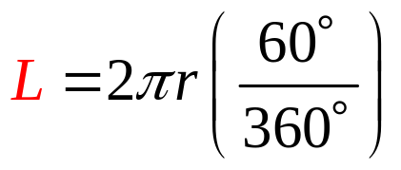
Just a few gentle reminders:
B
L
So if
A
r
C
But when we talk about arc length
Unlike the arc measurement, arc length will be measured in units of length
Notes:
Review the difference between an ‘arc’ and an ‘arc length’. Use winplot images with different colors to signify arc lengths

Slide 9
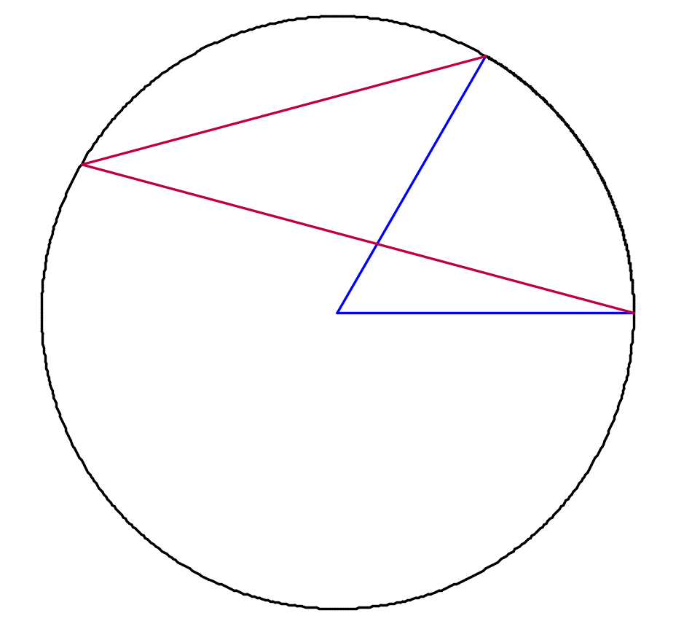

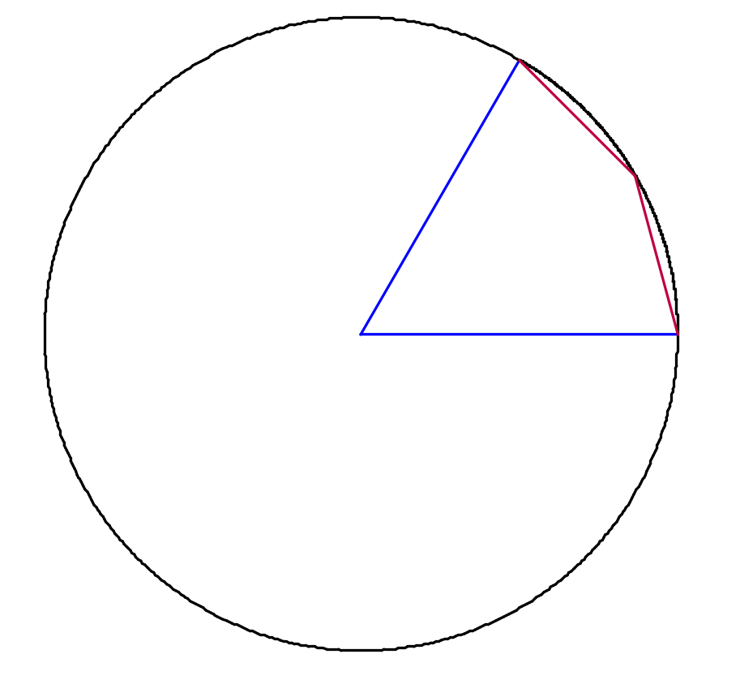

And for one more bit of review…
Think about this one…
?

Slide 10
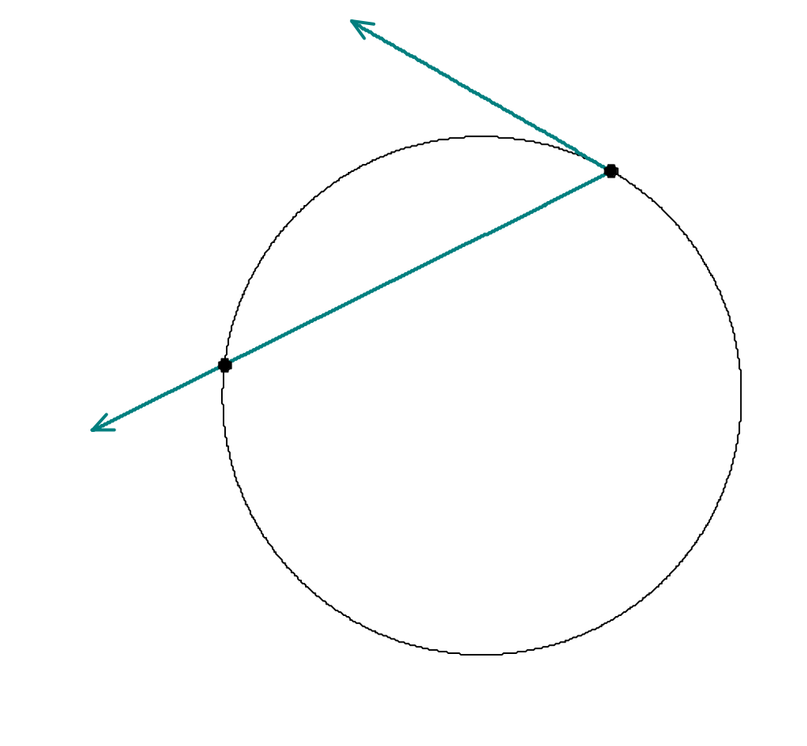





Just like inscribed angles, when an angle is formed by a secant line
and a tangent line,
it’s measurement will be half the arc (pg 830)
B
A
C

Slide 11
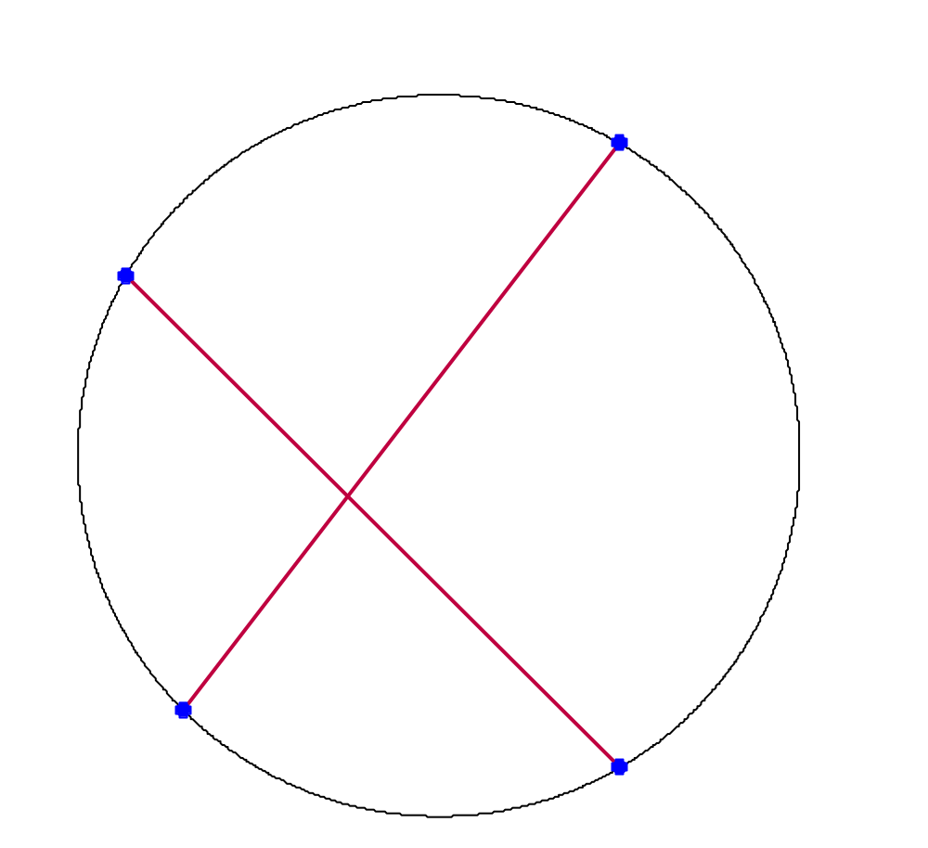

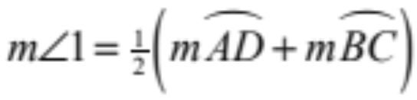


In this case,
(vertical angles) are the average of the two arcs (pg 831)
B
In other words
A
1
2
D
C

Slide 12
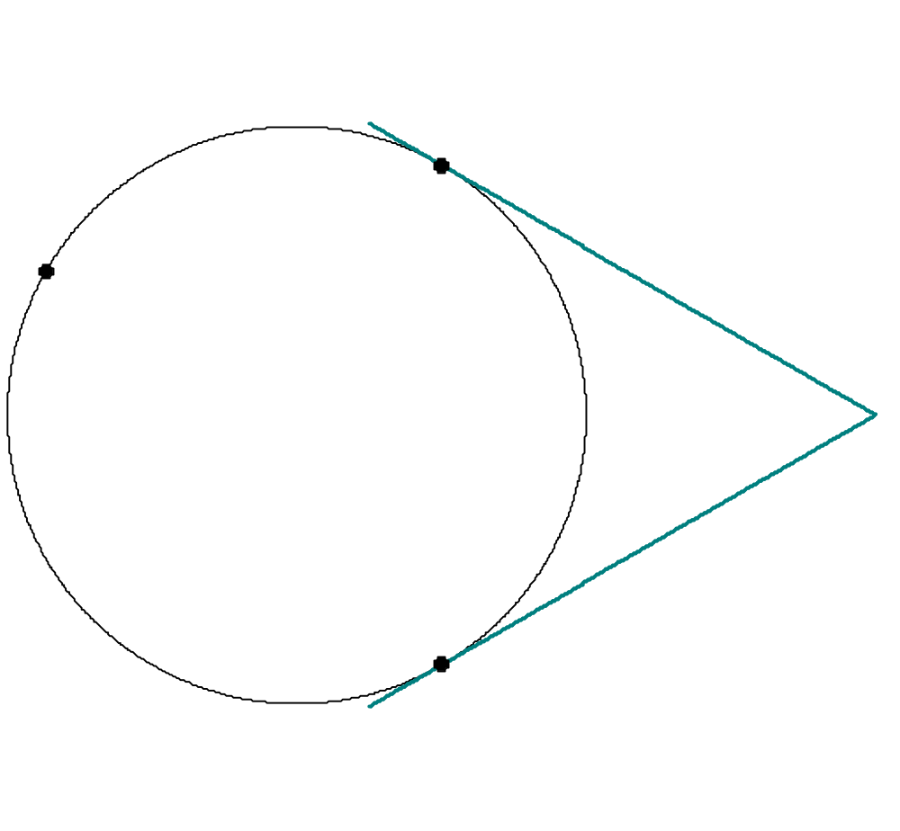
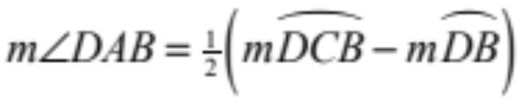




Once we get to angles formed outside the circle (pg 832) it becomes half the difference between the outer and inner arc measurements. In other words,
D
C
A
B

Slide 13
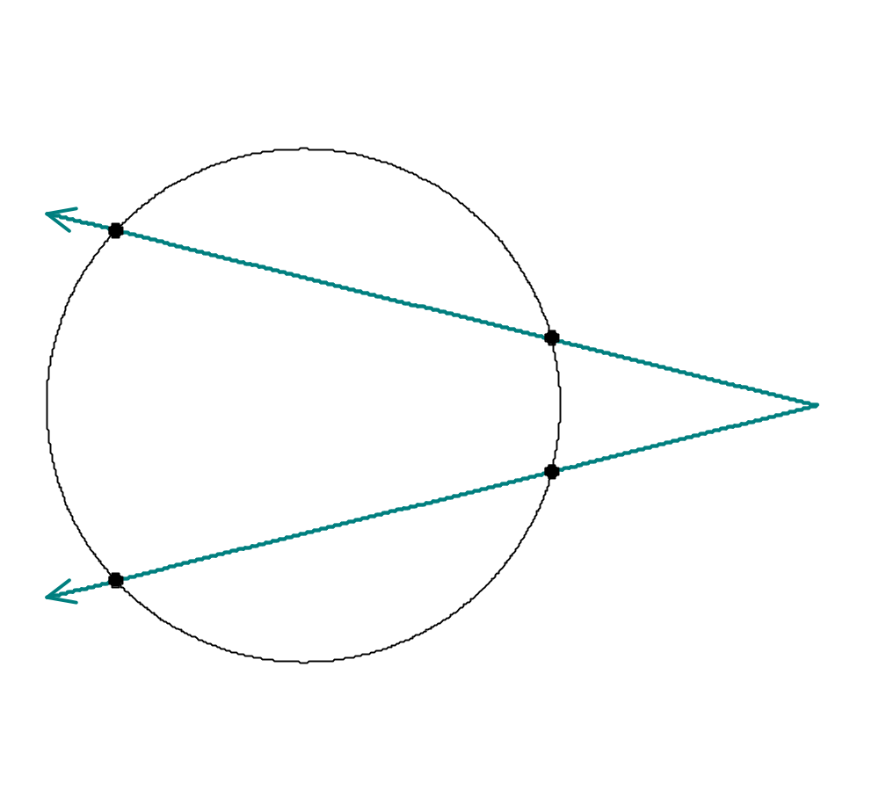
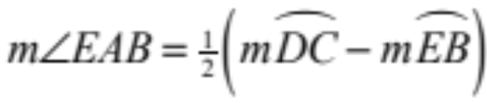




The same idea applies here
D
E
A
B
C

Slide 14
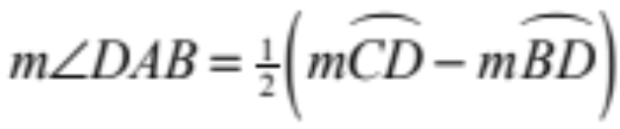
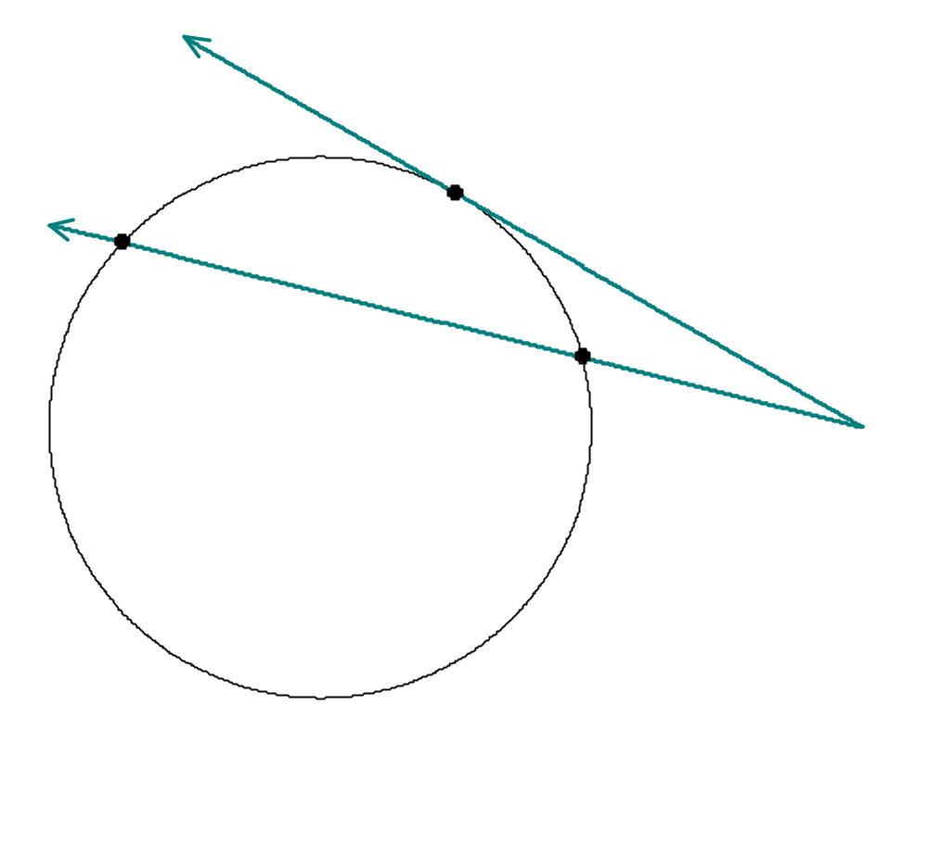




And here as well
D
C
B
A
Page 833 sums all of this up

