Slide 1
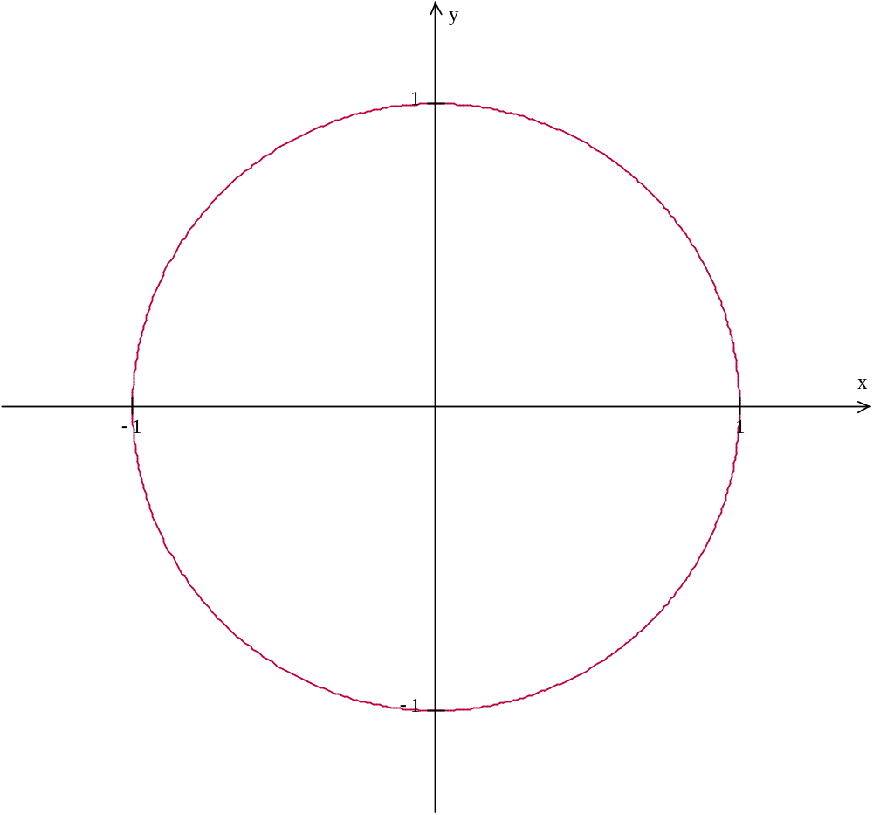
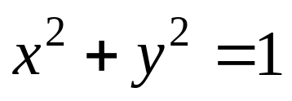
A Circle of radius 1

Slide 2
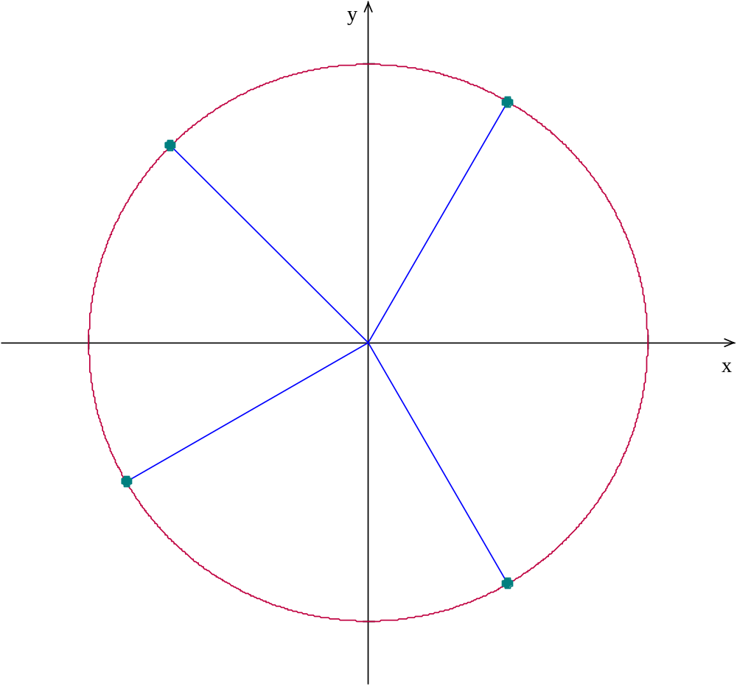
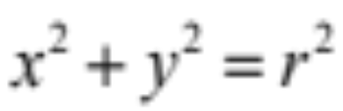
A Circle
Note the Pythagorean form
r
r
How does the Pythagorean theorem apply here?
r
The x and y coordinates are also side lengths of a right triangle with the radius as the hypotenuse
r
Regardless of the quadrant in which the points lie

Slide 3
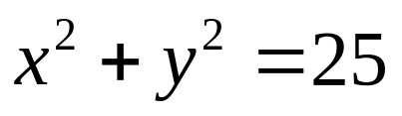
A Circle
Note the Pythagorean form
Notice also that each point on the circle is equidistant from the center
What if we altered the coefficients of the equation?

Slide 4
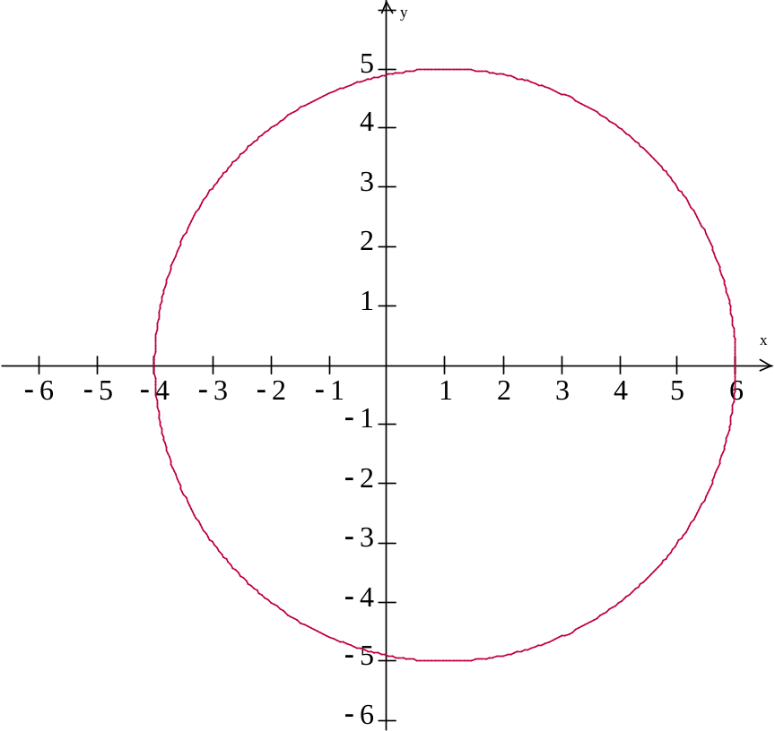
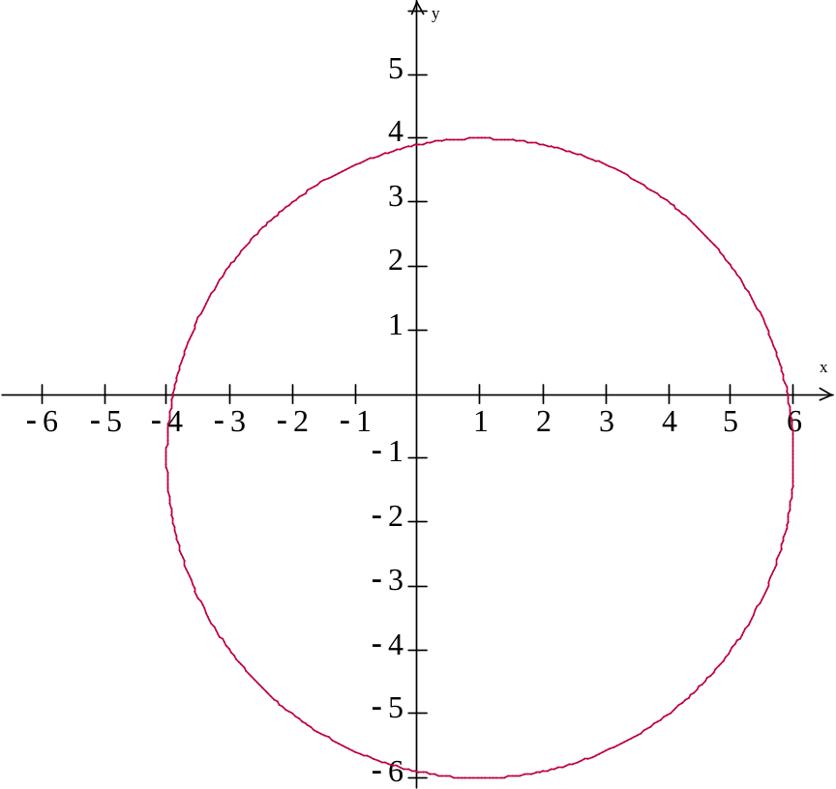
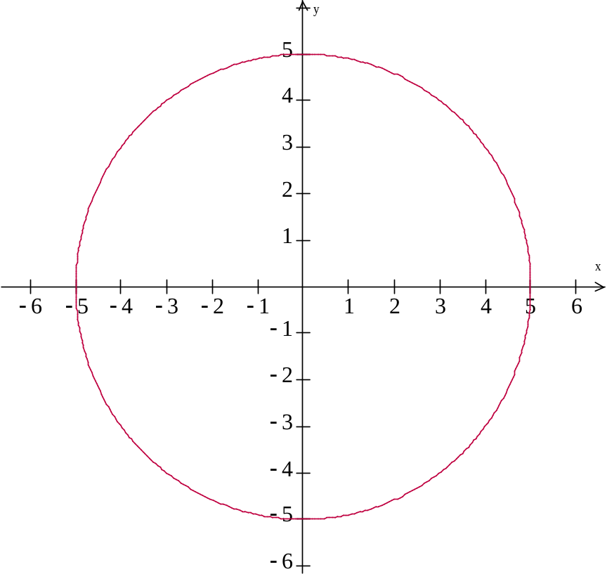
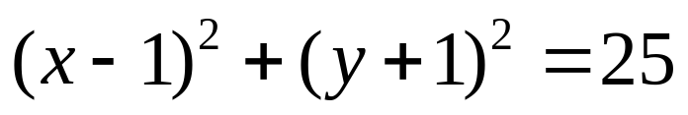
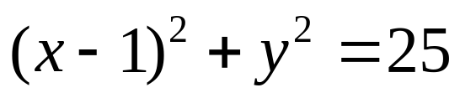
A Circle
So now our radius is 5
Remembering parabolas, what could I do to this equation to move the center 1 to the right?
How about 1 down?

Slide 5
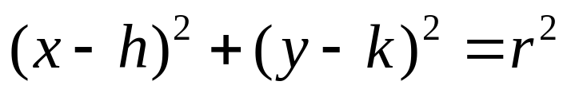
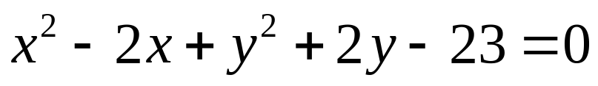
A Circle
So the general equation for a circle is:
With center (h, k) and radius r
What if your equation looked like this:
Hint: Try completing the squares
How?

Slide 6
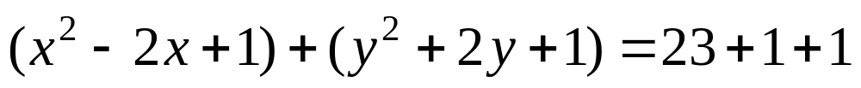
A Circle
So the general equation for a circle is:
With center (h, k) and radius r
What if your equation looked like this:
Add 1 to complete each square
Add the same numbers to the other side

