Slide 1
Traits & Graphs of Radical Functions
Standard 8c: Find the critical values and extreme points of radical functions
Standard 8d: Find all the traits and sketch a radical curve algebraically

Slide 2
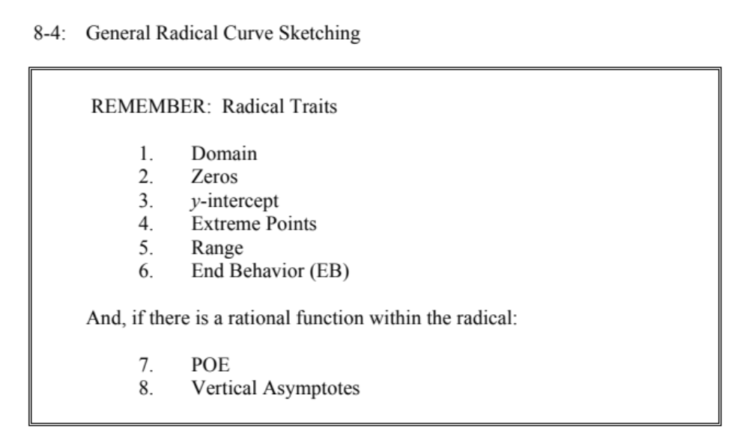
Pg 455

Slide 3
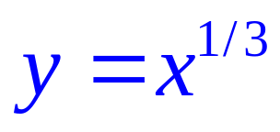
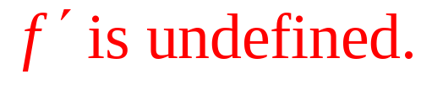
(not an extreme)

Slide 4
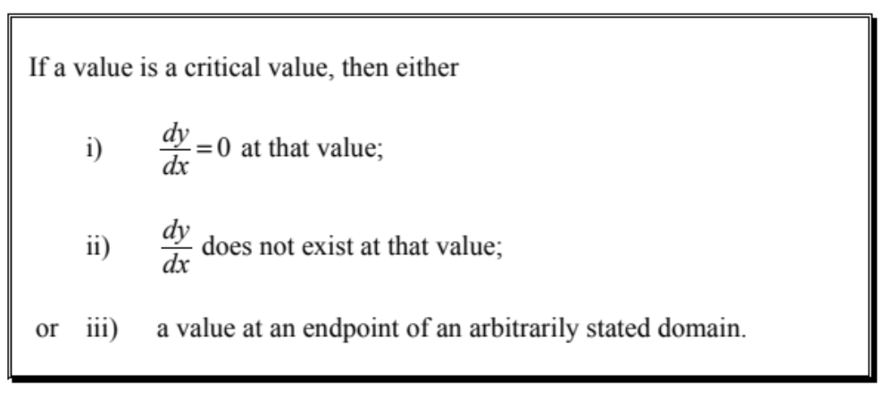

Slide 5
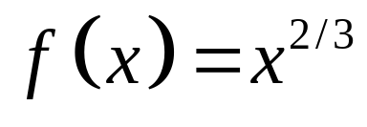
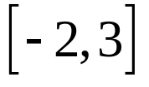
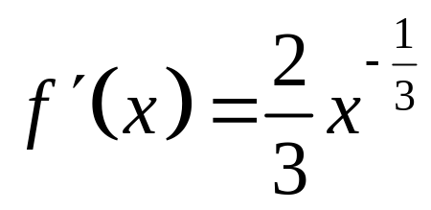
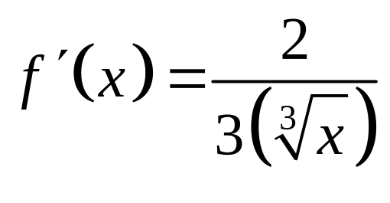
FINDING ABSOLUTE EXTREMA
Find the absolute maximum and minimum values of
on the interval .
There are no values of x that will make
the first derivative equal to zero.
The first derivative is undefined at x = 0,
so (0,0) is a critical point.
Because the function is defined over a
closed interval, we also must check the
endpoints.

Slide 6
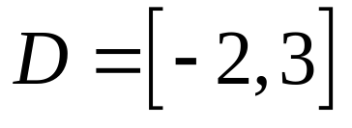

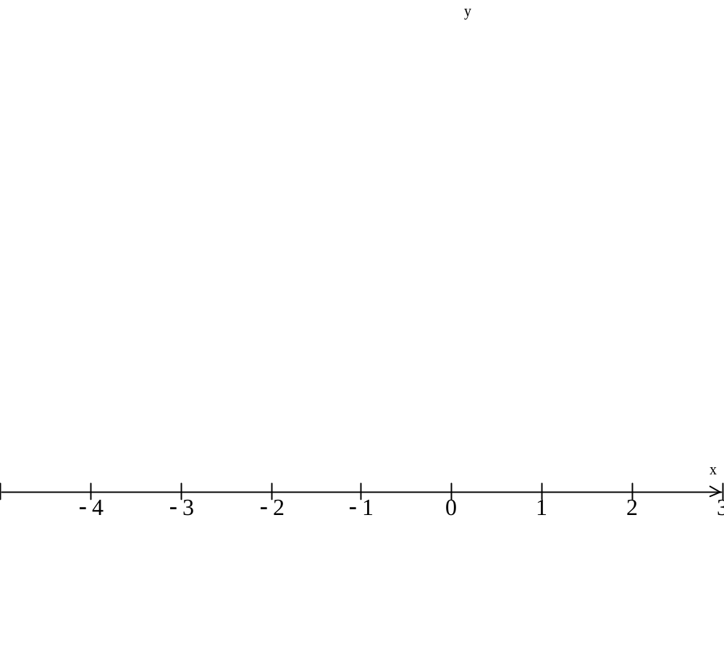



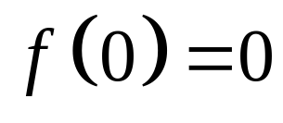
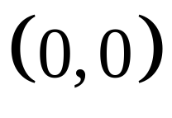

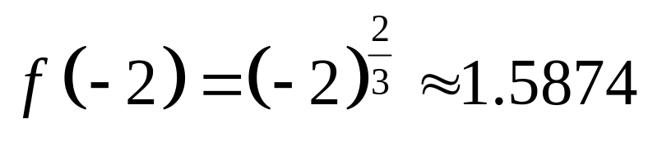
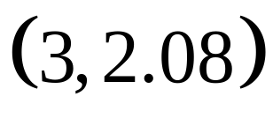
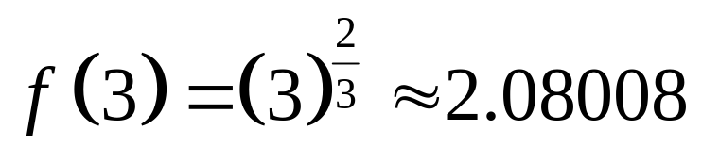

–
0
+
At:
Absolute
minimum:
At:
Absolute
maximum:
At:

Slide 7
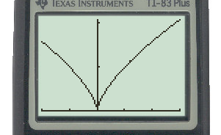
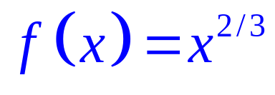
Absolute maximum (3,2.08)
Absolute minimum (0,0)

Slide 8
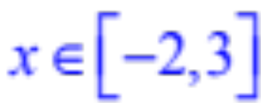


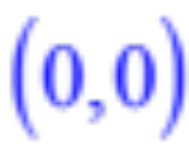
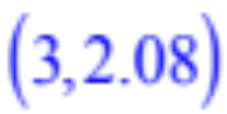
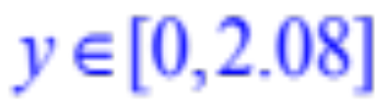
Absolute
minimum:
Absolute
maximum:
Since our domain is restricted we won’t worry about end behavior

Slide 9
Finding Maximums and Minimums Analytically:
1
Find the derivative of the function, and determine where the derivative is zero or undefined. These are the critical points.
2
Find the value of the function at each critical point.
3
Find values or slopes for points between the critical points to determine if the critical points are maximums or minimums.
4
For closed intervals, check the end points as well.

Slide 10
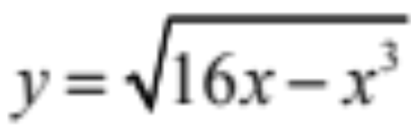
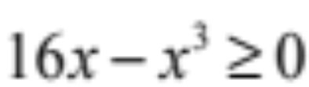
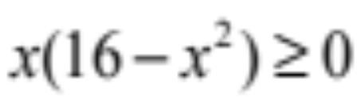
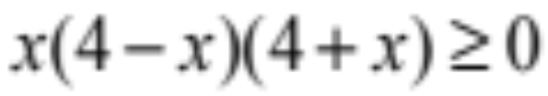
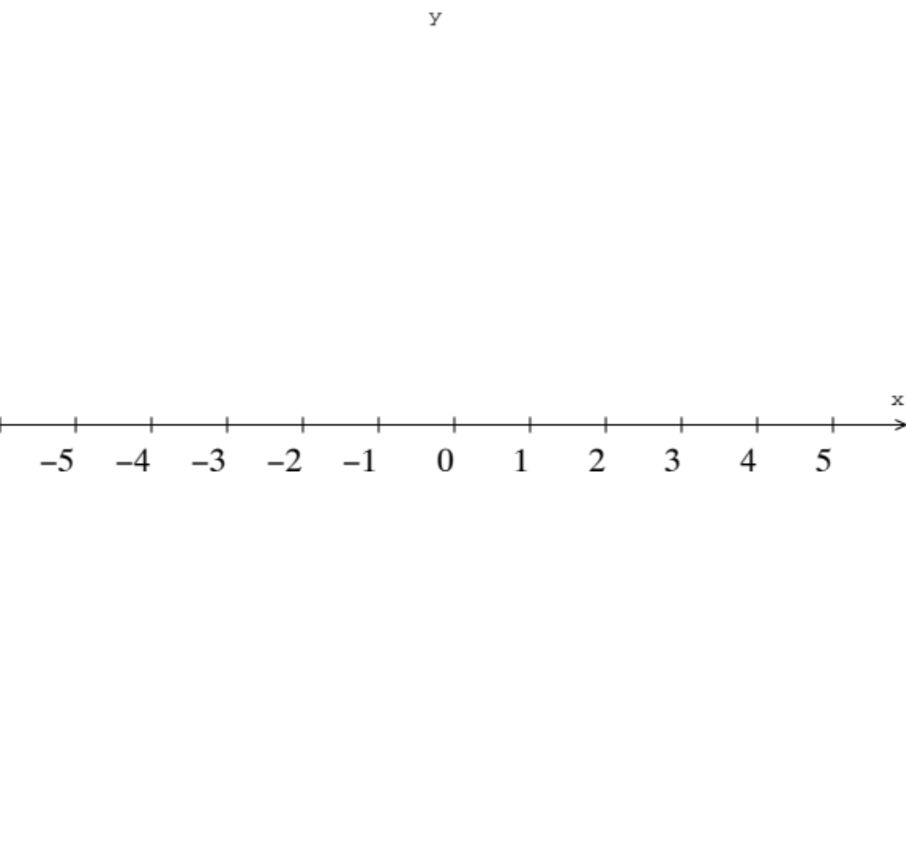
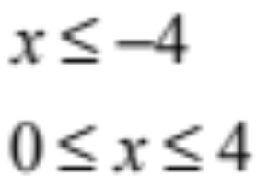
Find the domain of
What values of x give us something with a real number square root?
Now make a sign pattern number line
+
0
−
0
+
0
−

Slide 11
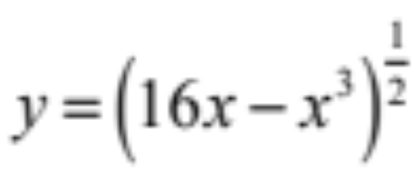
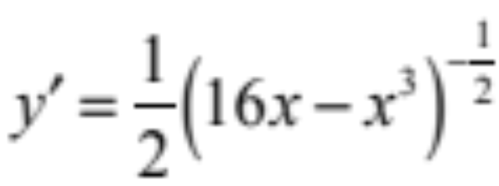
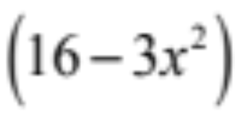

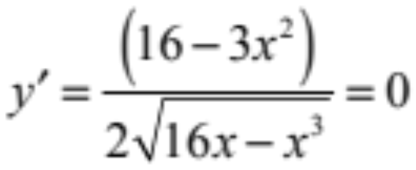
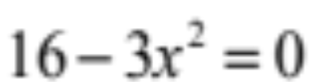
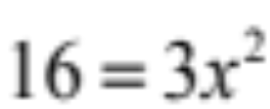
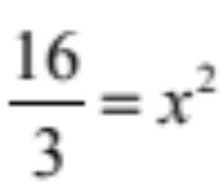
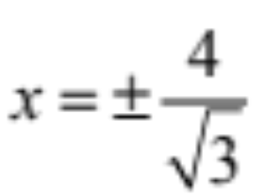
Differentiate:
Re-write with an exponent
Don’t forget the inside
Now find the critical points
(Where is 0 or undefined)
or where

Slide 12
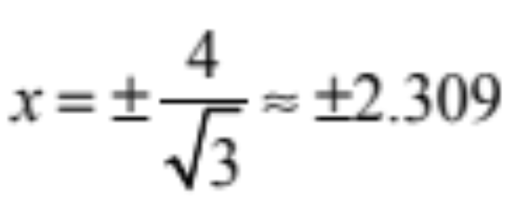
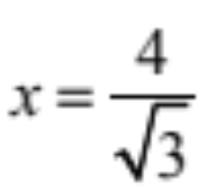
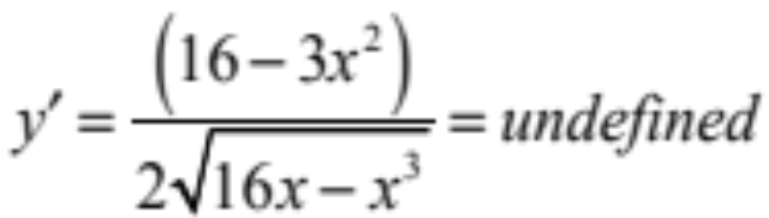
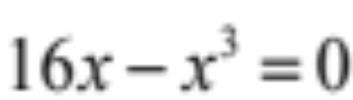
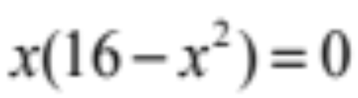

But the only value that works here is…
Because the other value is not in the domain
Why?
Recall that the domain is
Now find the critical points
(Where is 0 or undefined)
or where

Slide 13
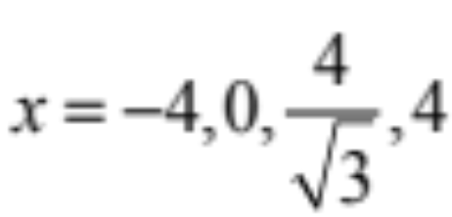
So the critical values here are
So how do we do this again?
Find the domain of the radical function
Differentiate (don’t forget the Chain Rule)
Find the critical points
  where the derivative is 0 (numerator)
  where the derivative is undefined (denominator)
Check the critical points against the domain
Make a sign pattern to locate the minima and maxima
And one more thing…

Slide 14
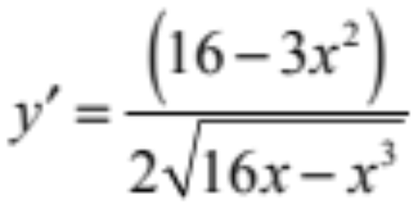
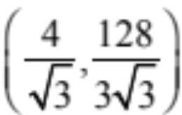

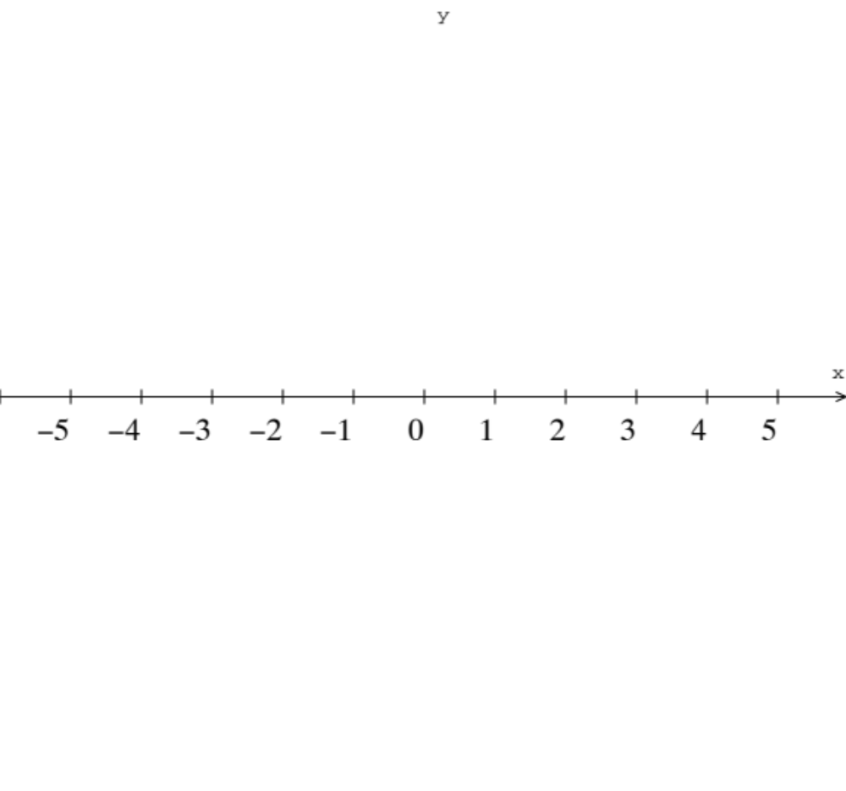
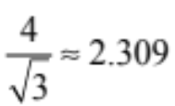
So the critical values here are
So where are the maxima and minima?
Here is where we will need to make the sign pattern
is a maximum
−
not in the domain
+
−
not in the domain
dne
dne
0
dne

Slide 15
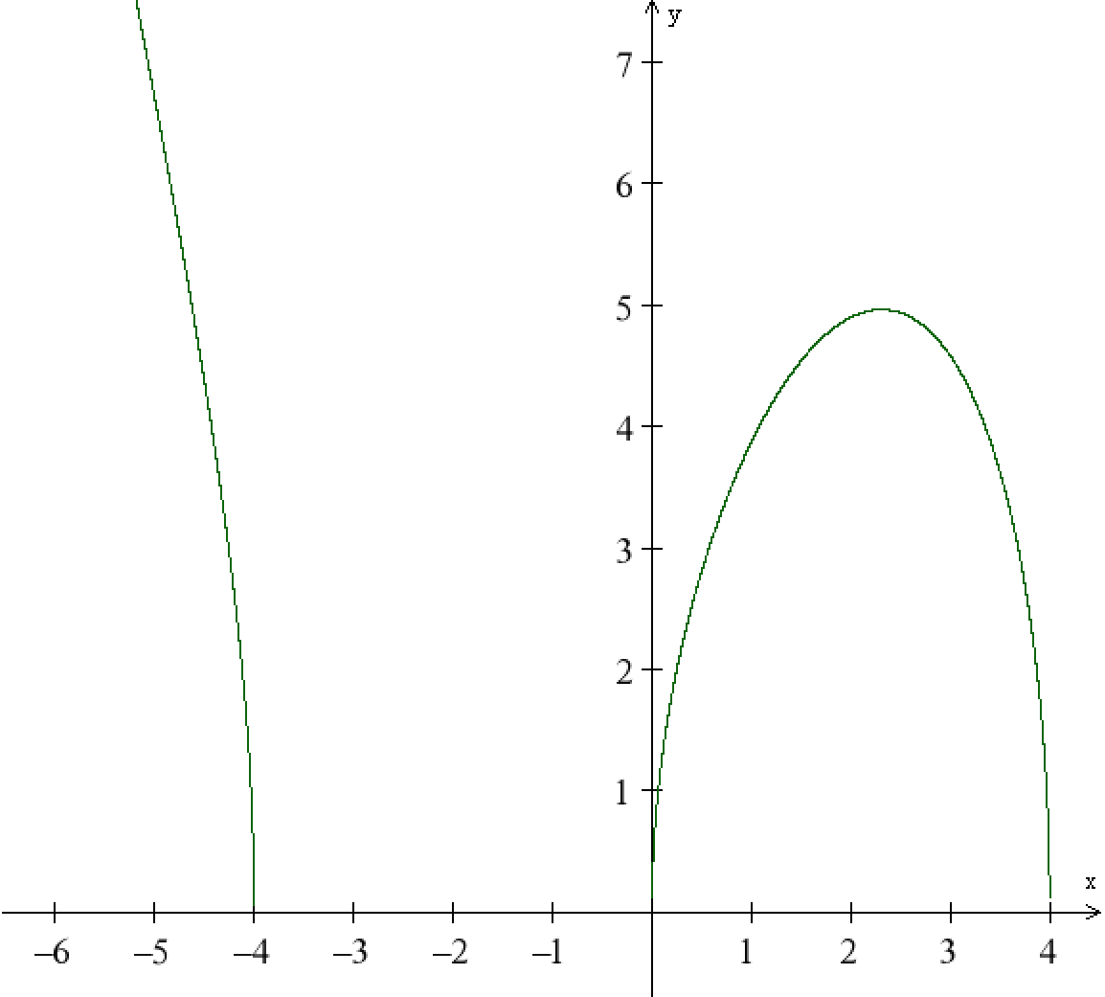

is a maximum
−
not in the domain
+
−
not in the domain
dne
dne
0
dne

Slide 16


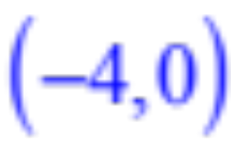
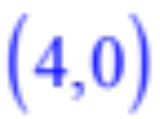
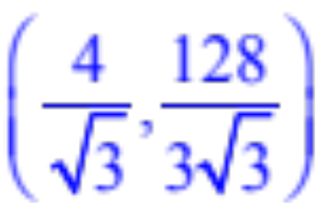
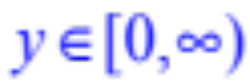
Recall we can write it either way
Absolute
minimums:
Relative
maximum:
Since our domain is restricted we only need to worry about the left side which has the function coming down from infinity

