Slide 1
Traits & Graphs of Radical Functions
Standard 8c: Find the critical values and extreme points of radical functions
Standard 8d: Find all the traits and sketch a radical curve algebraically

Slide 2
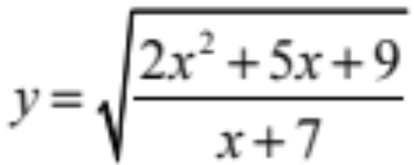
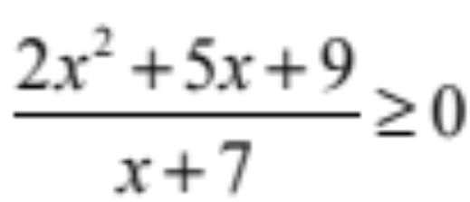
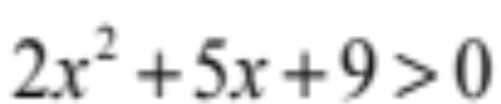
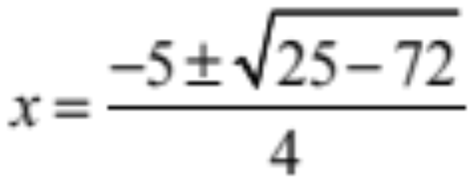

Find the traits and graph of
Let’s start with the domain
What values of x give us something with a real number square root?
For all x values. It is an upward opening parabola that has no x intercepts because…
The quadratic formula would give us
This leaves the denominator x + 7 > 0

Slide 3
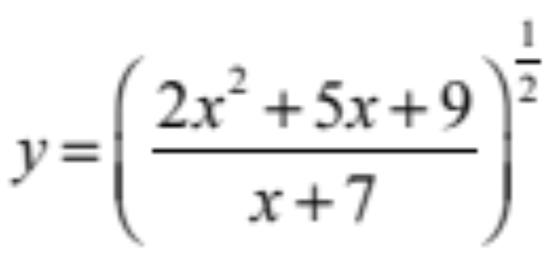
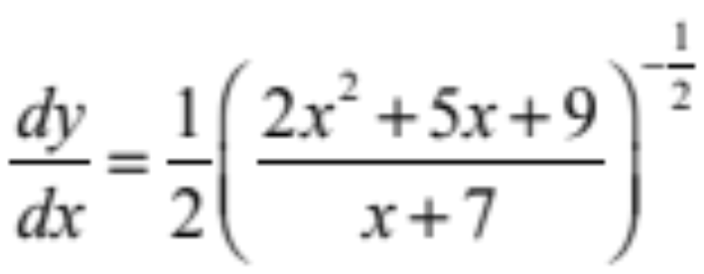
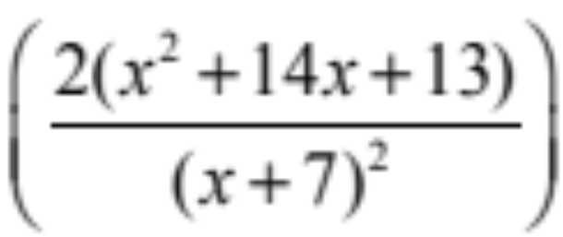
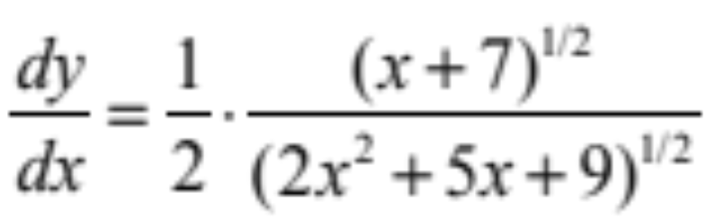


Differentiate:
Re-write with an exponent
Don’t forget the inside
which requires the Quotient Rule
Simplify
Now find the critical points
We accounted for these when we found the domain so no critical points in the denominator
(Where is 0 or undefined)

Slide 4
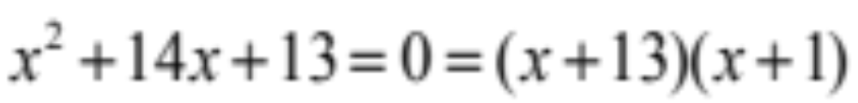

Differentiate:
Re-write with an exponent
Don’t forget the inside
which requires the Quotient Rule
But this can be factored
Now find the critical points

Slide 5




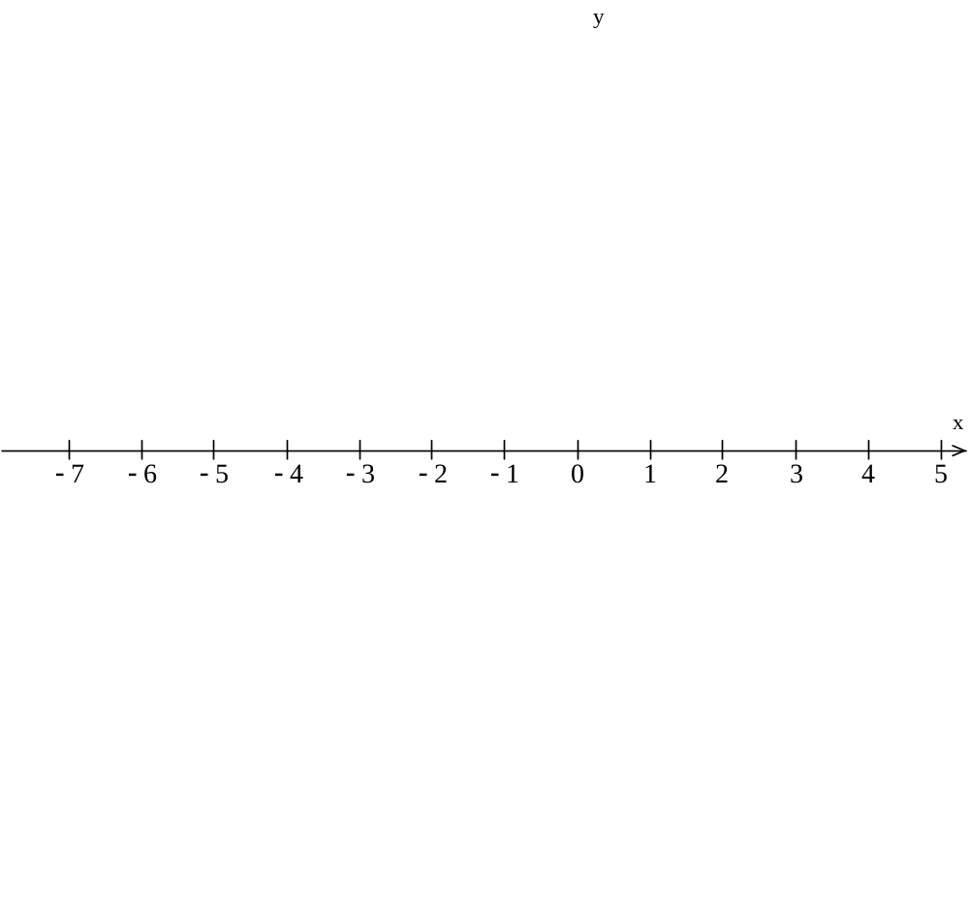
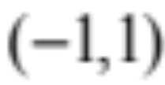
But the only value that works here is…
Because the other value is not in the domain
Why?
Recall that the domain is
Now let’s look at the sign pattern
not in the domain
–
0
+
x
Plug –1 in and we have a minimum at

Slide 6
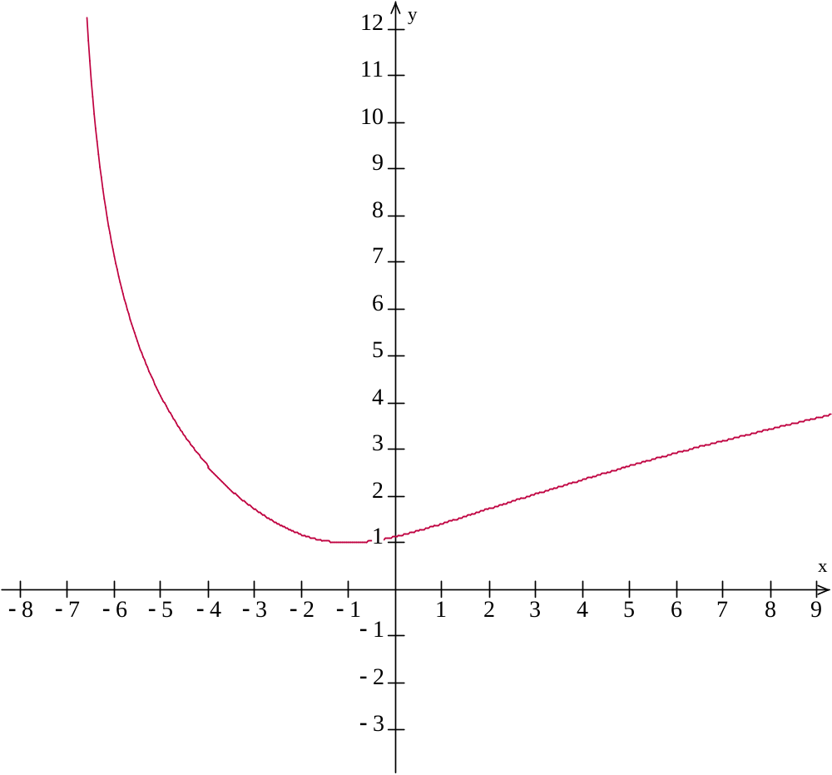
Now let’s compare the sign pattern to the graph on the right
not in the domain
–
0
+

Slide 7
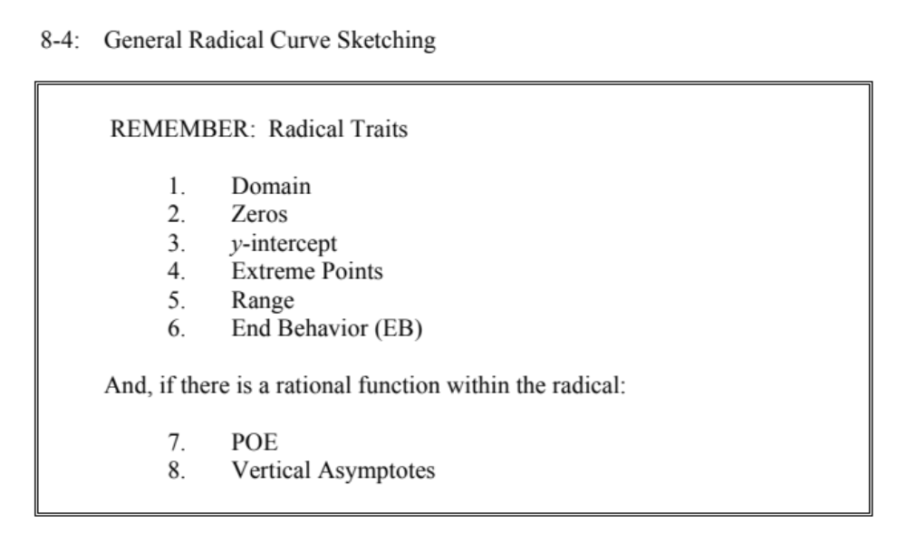

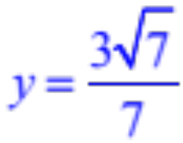
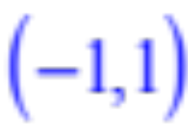

None
Plug 0 in for x to confirm
Absolute
minimum:
Since our domain is restricted we say that it comes down from the left short of –7 and goes up to ∞ on the right

