Slide 1
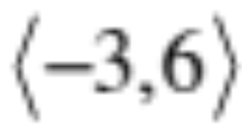
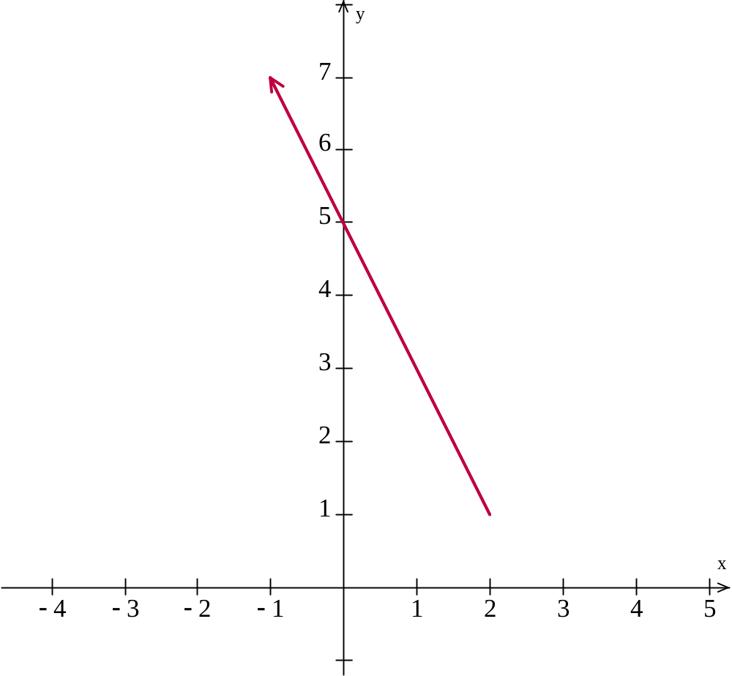
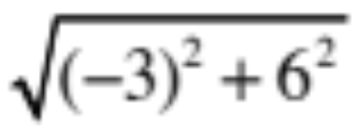
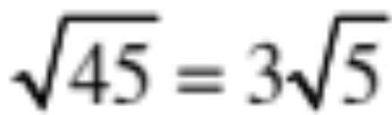
Find the component form, sketch and find the length of the vector with initial point (2, 1) and terminal point (–1, 7)
6
–3

Slide 2
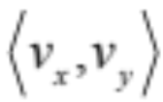


This is a Vector
It appears as a line segment that connects two points
8-6 Vectors in a Plane
It also has something else:
Direction
But the best part is
it’s really just the hypotenuse of a right triangle
What are those symbols next to each line segment?
We shall soon see.
Greg Kelly, Hanford High School, Richland, Washington

Slide 3
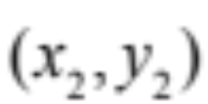
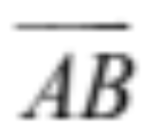
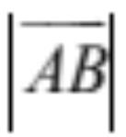

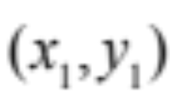

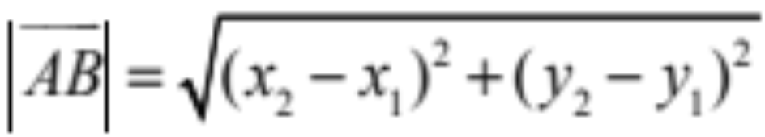
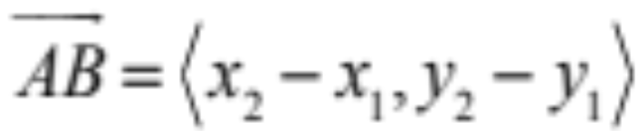
The length is of this vector is written as
terminal
point
B
It can be calculated like this:
A
initial
point
Look, it’s just the distance formula
The component form of this vector is:
The horizontal change in position
The vertical change in position

Slide 4
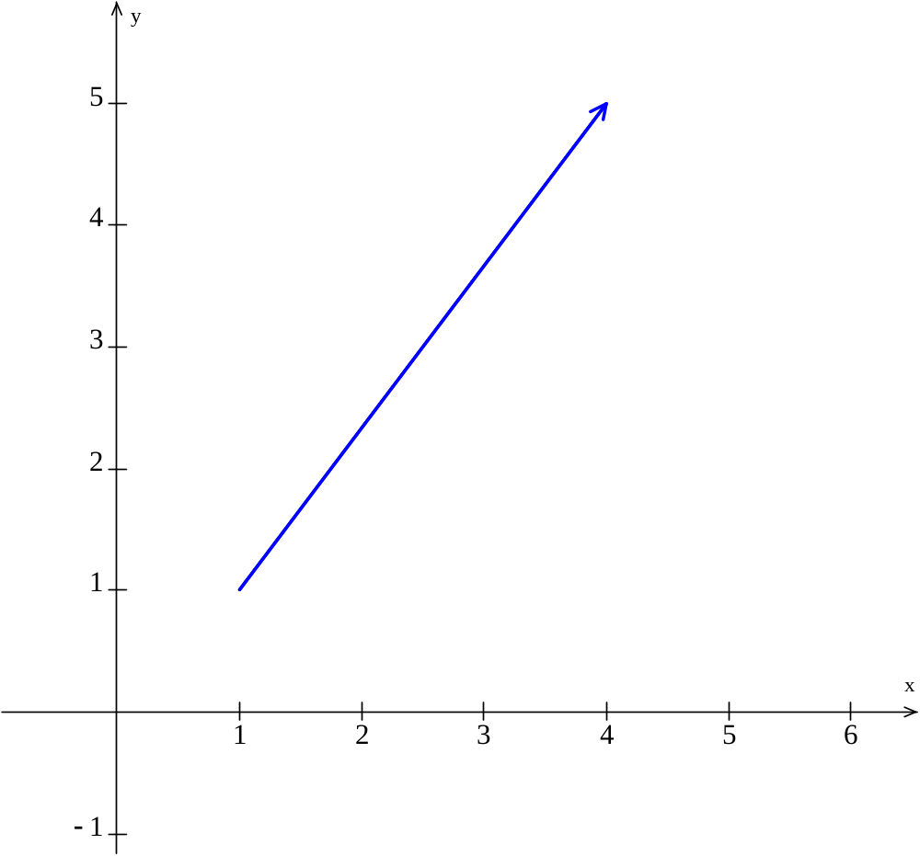
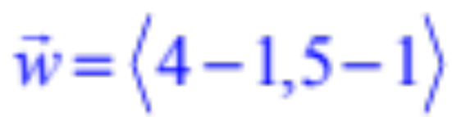
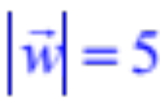

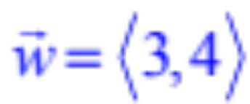

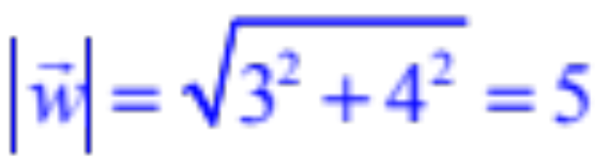
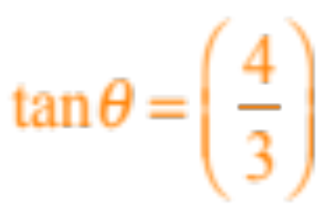
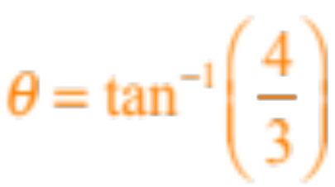

What is the component form of this vector?
(4, 5)
4
What is the length (or magnitude) of this vector?
Remember that the vector is just the hypotenuse
(1, 1)
3
By the way, this angle is called the direction that Greek symbol is called Theta
What is the measure of this angle?
Since
We’ll just use the calculator

Slide 5
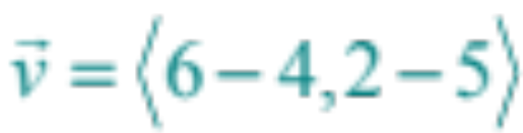

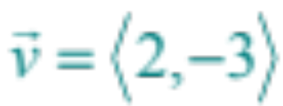
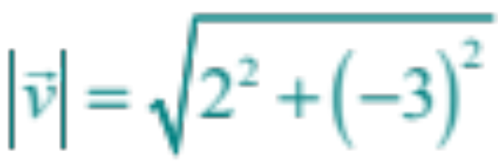
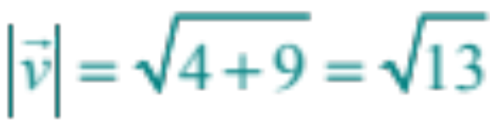
Let’s add a vector
(4, 5)
And the length of this vector is
(6, 2)

Slide 6
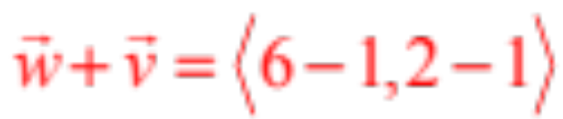
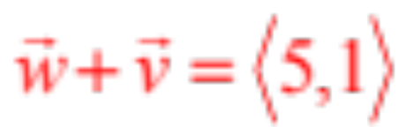



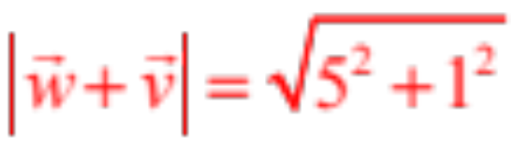

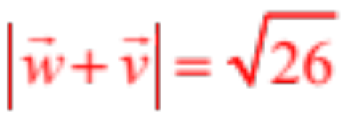
Let’s add these two vectors
(4, 5)
And the length of this vector is
(6, 2)
(1, 1)
What is the measure of this angle?
Notice that we have an acute triangle and we know all three sides
For this we will need the Law of Cosines

Slide 7
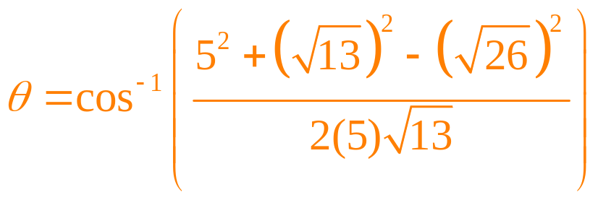
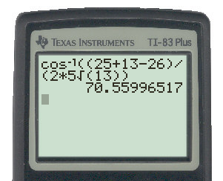

What is the measure of this angle?
(4, 5)
Notice that we have an acute triangle and we know all three sides
For this we will need the Law of Cosines
(6, 2)
(1, 1)

Slide 8
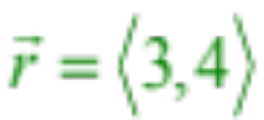
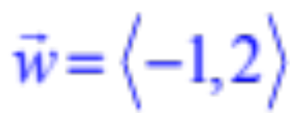



Now let’s assume that this vector represents Mike May, Donovan Jones, and Mac Gates rowing a boat across Lake Merced at 5 mph.
The current of the lake is flowing in the direction of
How will the current affect the direction of their boat?
In other words find the resultant vector
4
3

Slide 9

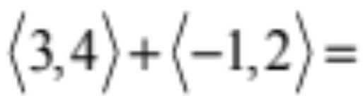
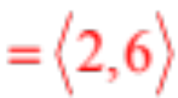
Now let’s assume that this vector represents Mike May, Donovan Jones, and Mac Gates rowing a boat across Lake Merced at 5 mph.
The current of the lake is flowing in the direction of
How will the current affect the direction of their boat?
6
In other words find the resultant vector
Assuming units of miles per hour, how fast are they going after the current affects them?
2

Slide 10
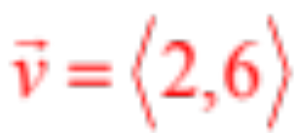
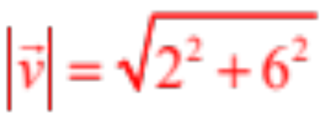
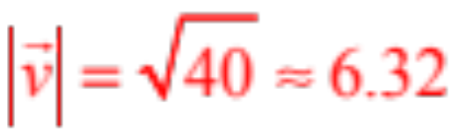
Now let’s assume that this vector represents Mike May, Donovan Jones, and Mac Gates rowing a boat across Lake Merced at 5 mph.
The current of the lake is flowing in the direction of
Assuming units of miles per hour, how fast are they going after the current affects them?
In other words, what is the magnitude of the new vector?
6
mph
2

Slide 11

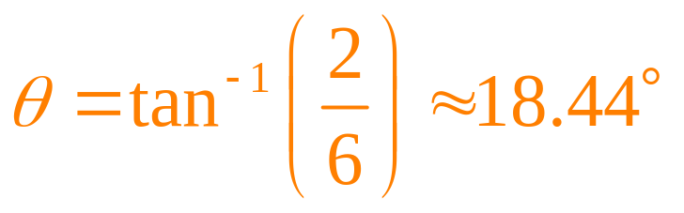

Now let’s assume that this vector represents Mike May, Donovan Jones, and Mac Gates rowing a boat across Lake Merced at 5 mph.
The current of the lake is flowing in the direction of
2
How many degrees east of north are they now moving?
In other words what is the value of this angle?
6
6
2

