Slide 1
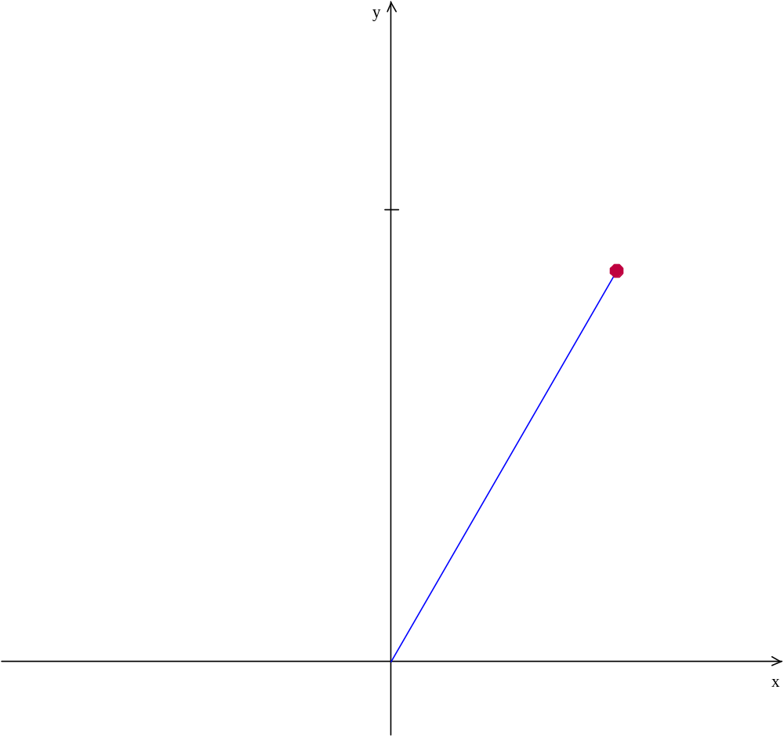
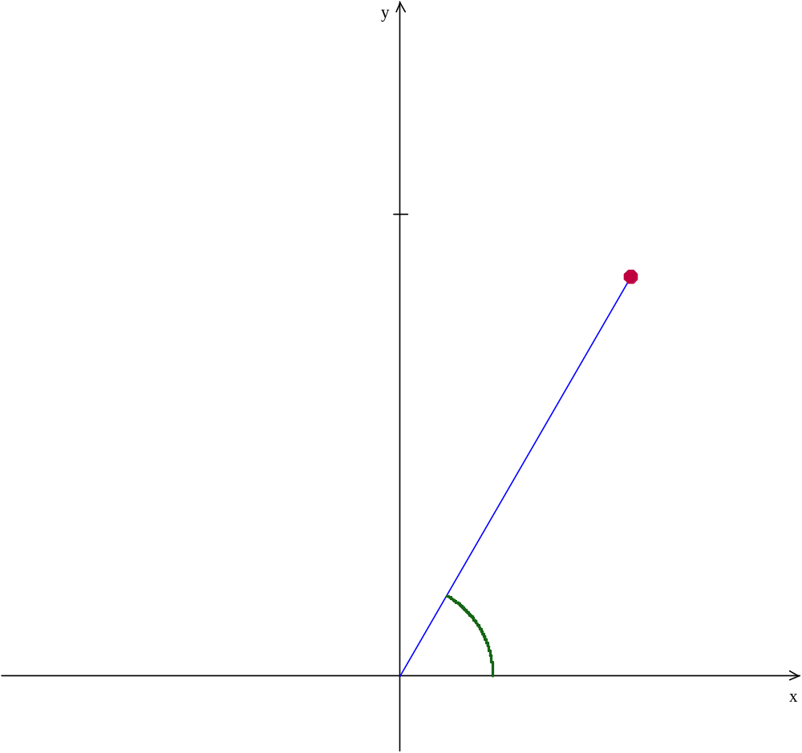
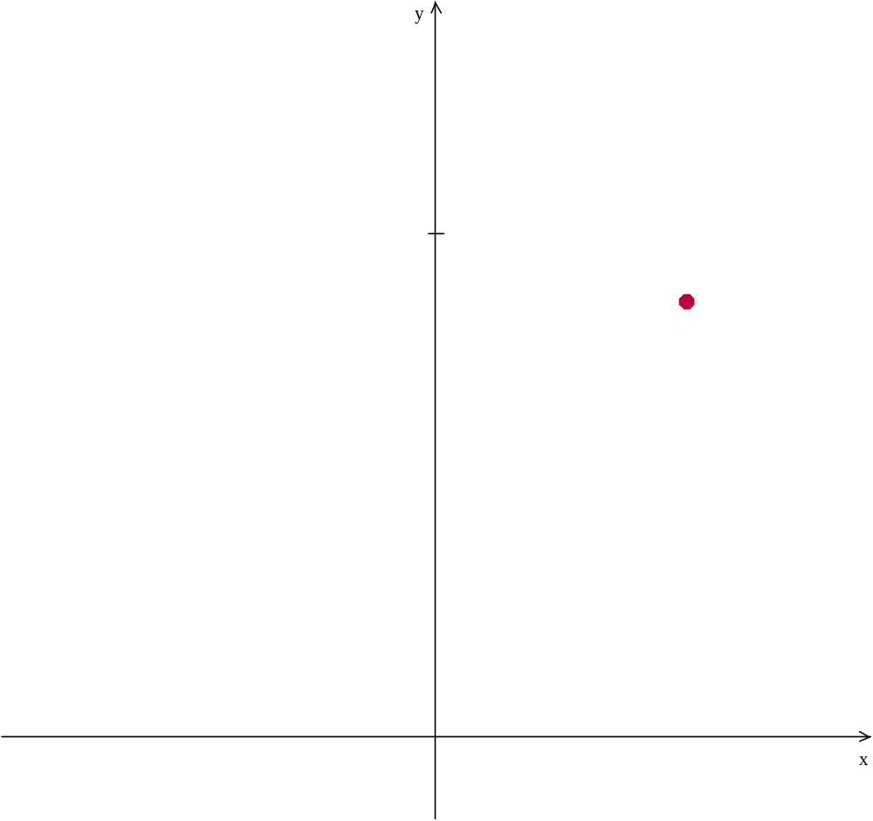
The terminal side of the angle here is r
We’ll worry about the length of r later
r
α
Starting α from the positive x-axis is called Standard Position

Slide 2
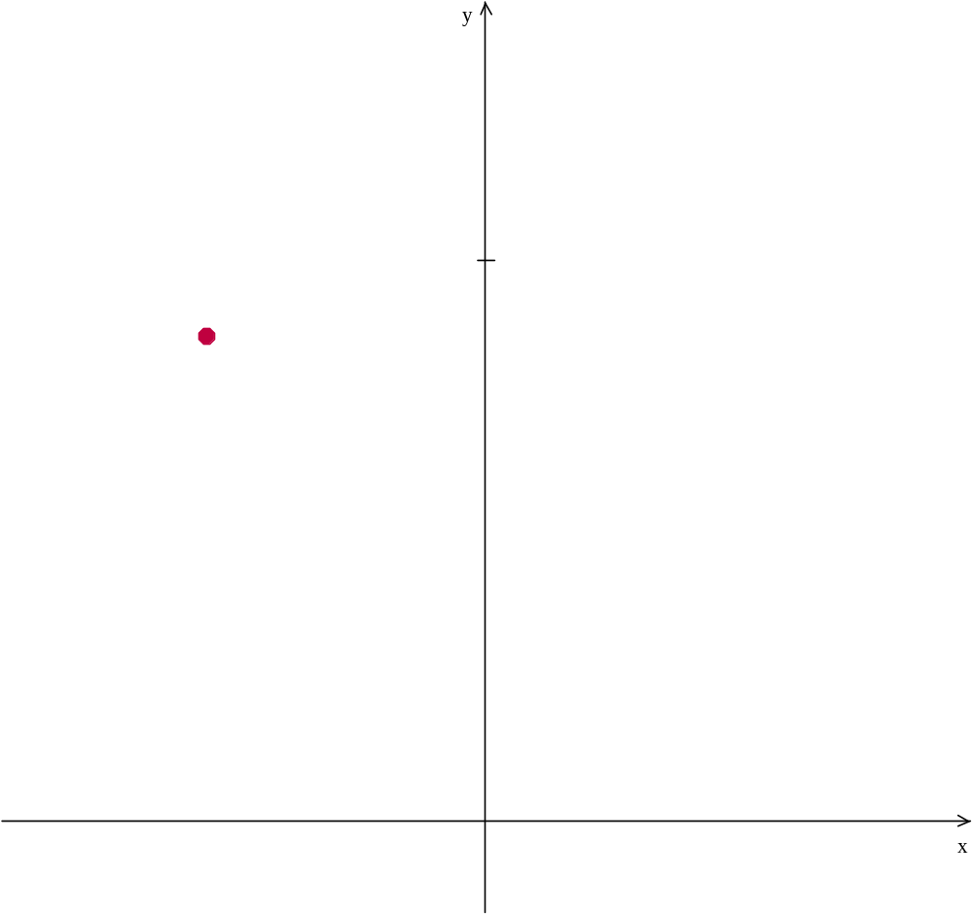
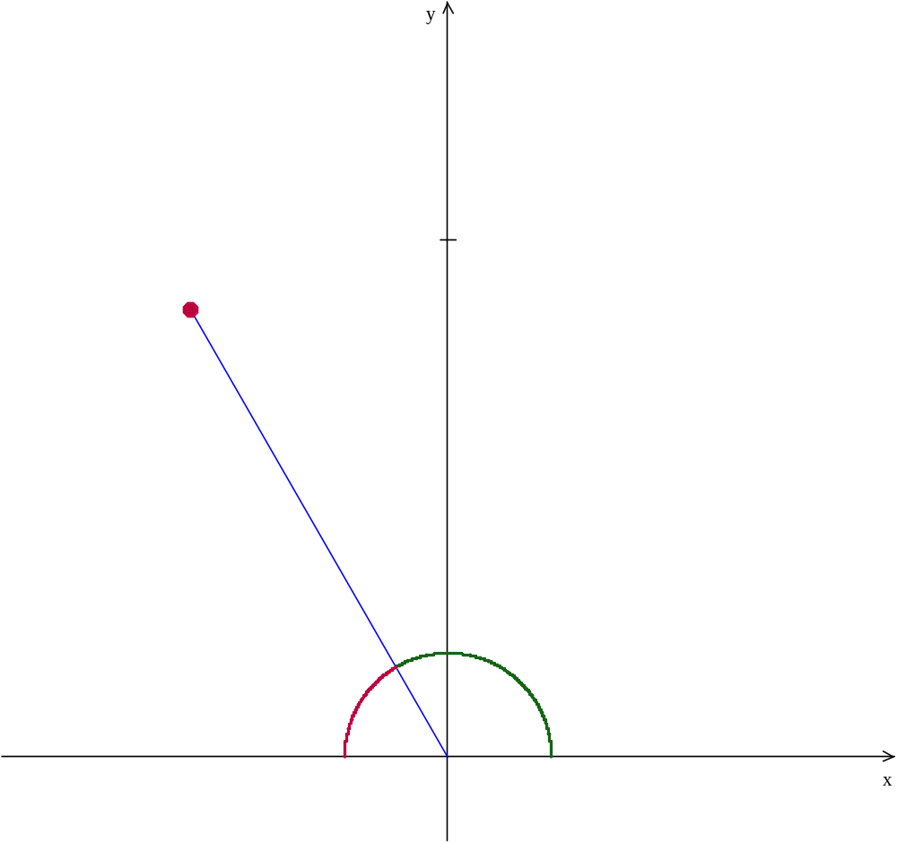
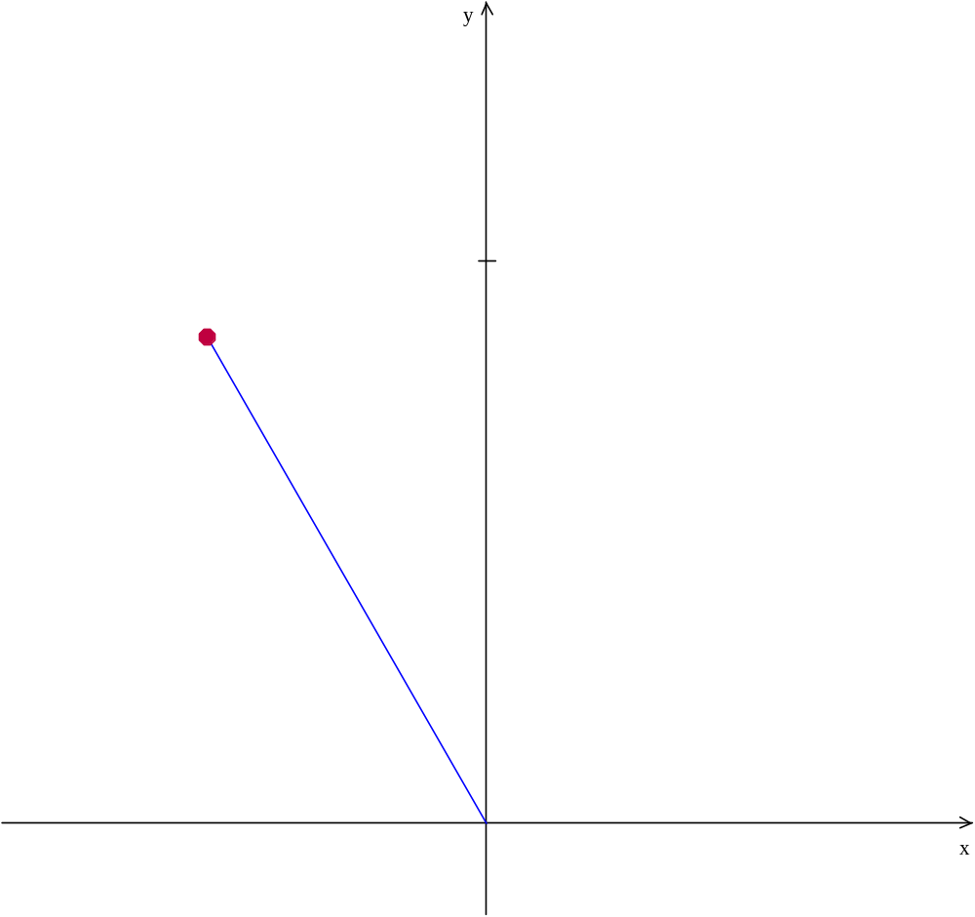
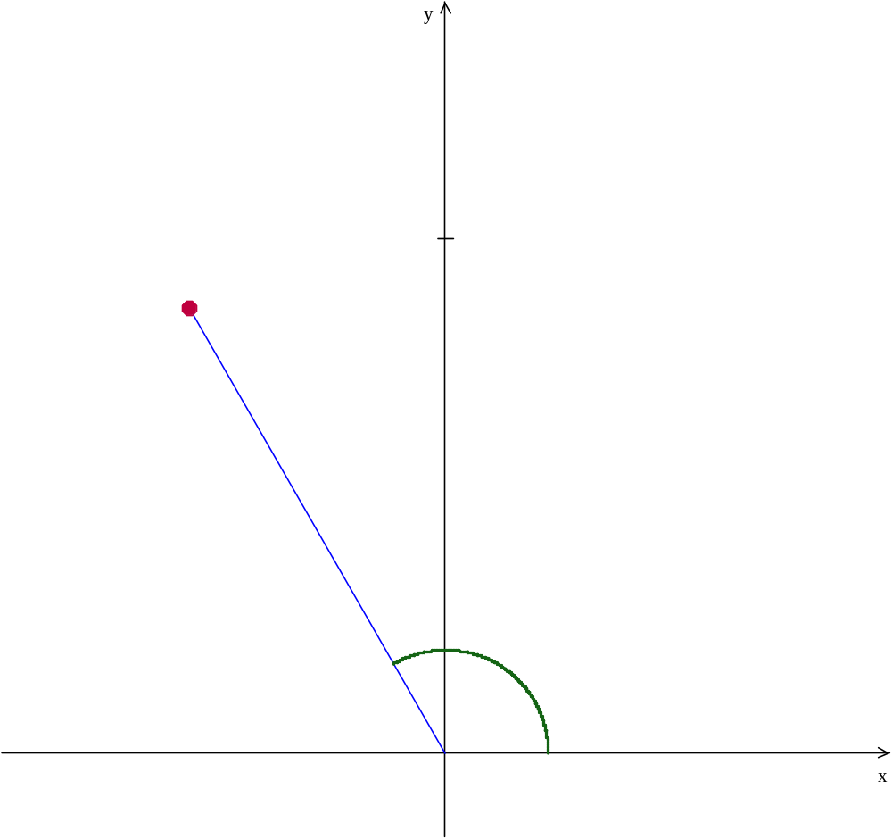

θ is called the reference angle
reference angle
The acute angle made between the terminal side (r)
r
and the x-axis
More on this later
θ

Slide 3
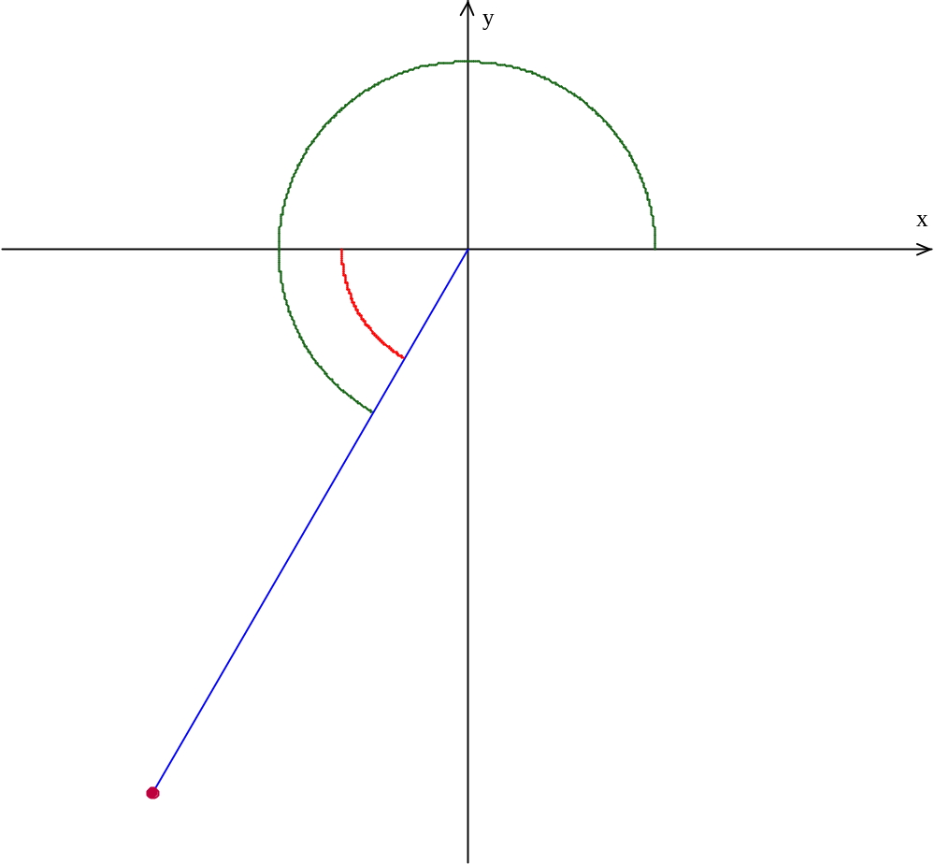
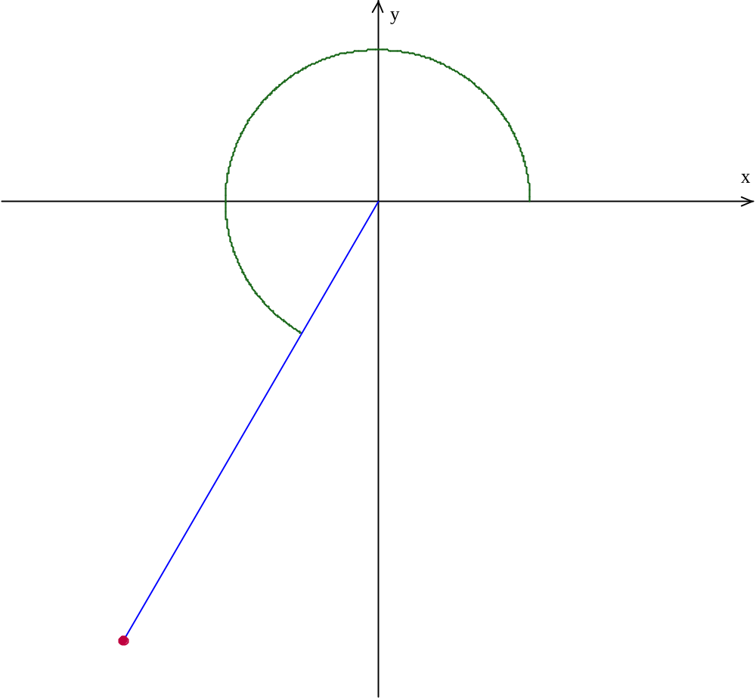

θ is called the reference angle
reference angle
θ
The acute angle made between the terminal side (r)
and the x-axis
r

Slide 4
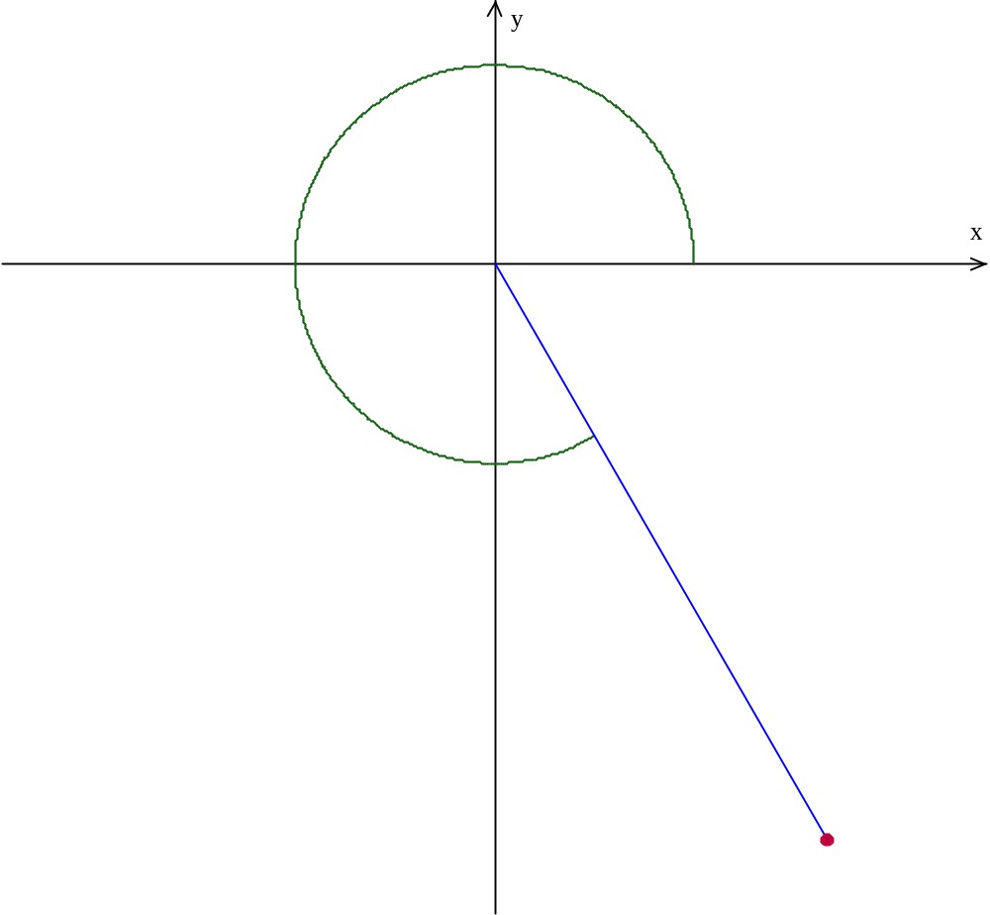
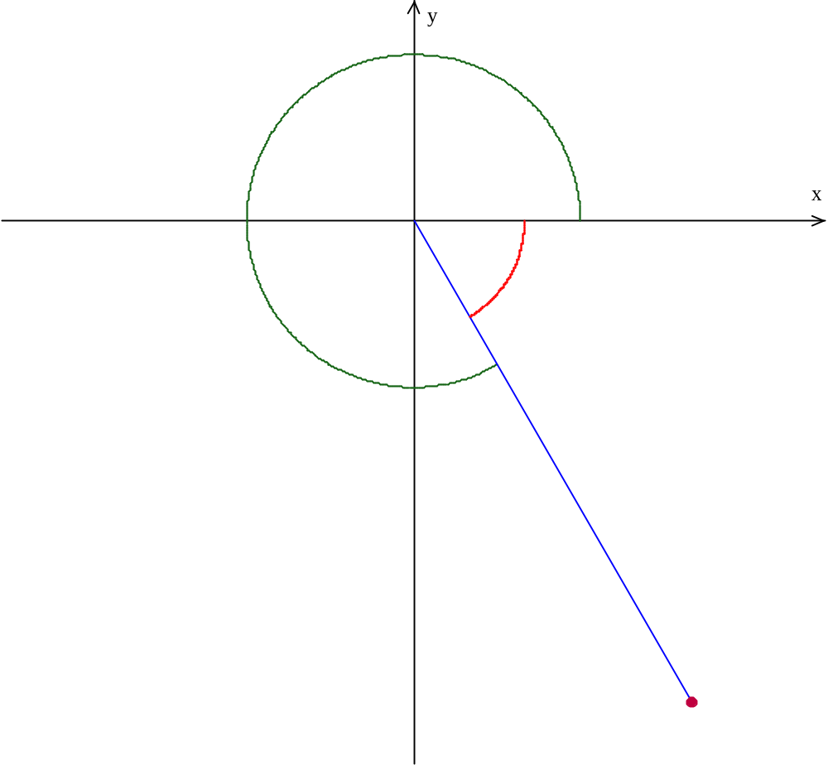
θ is called the reference angle
reference angle
θ
The acute angle made between the terminal side (r)
and the x-axis
r

Slide 5

Co-terminal angles
Angles that have the same initial and terminal sides
r
β
α and β are examples of co-terminal angles.
Co-terminal angles always differ by multiples of 360°
Notes:
Left off here

Slide 6




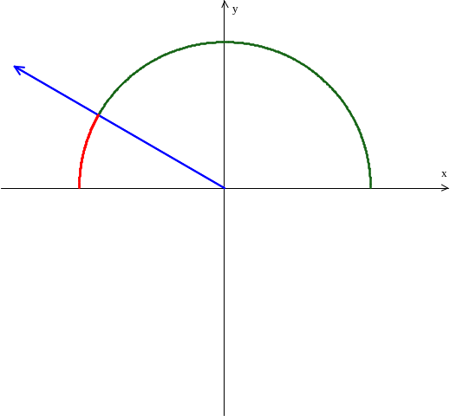
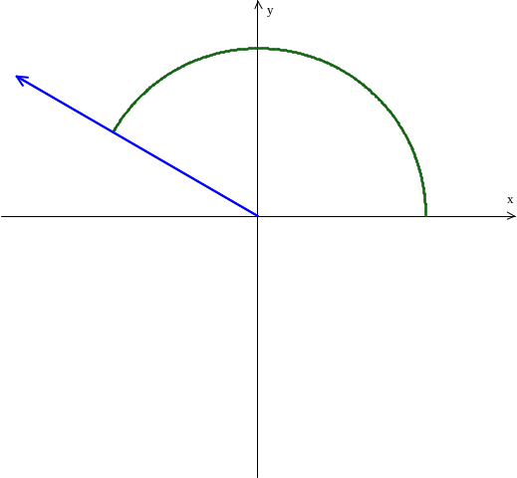
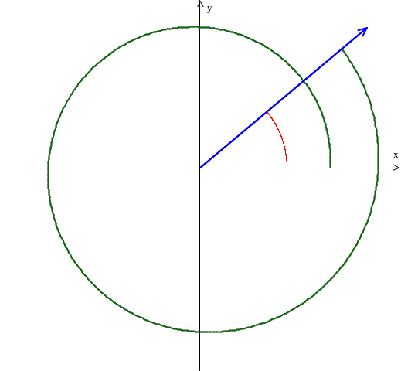
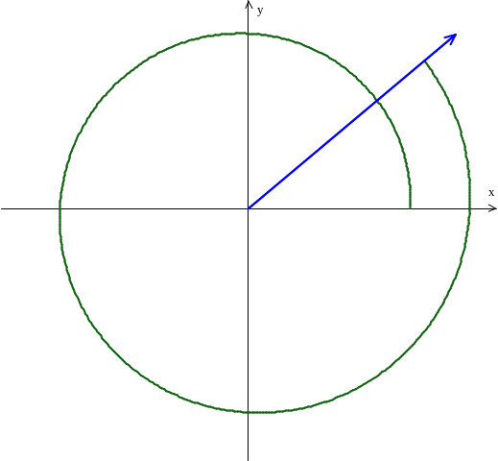




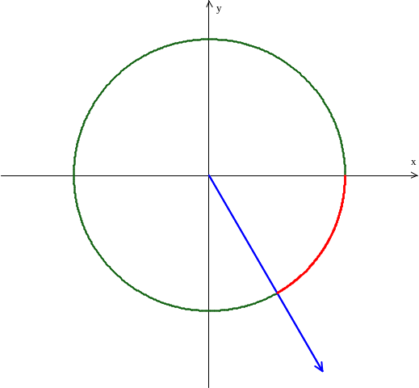
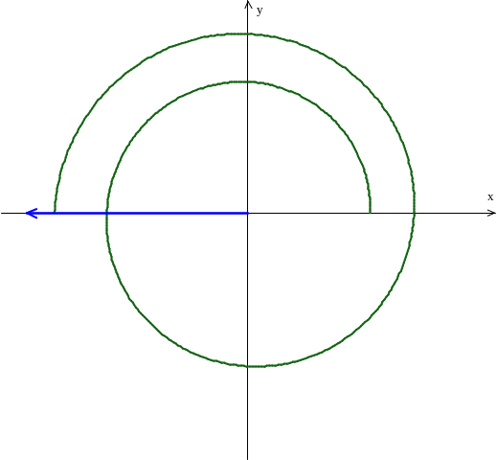
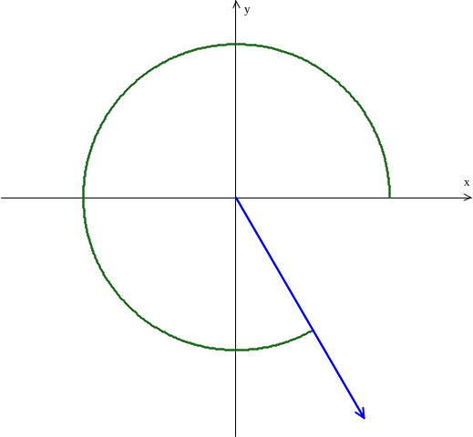
Draw the given angles on the x-y plane
reference angle =
reference angle =
reference angle =
reference angle =

Slide 7



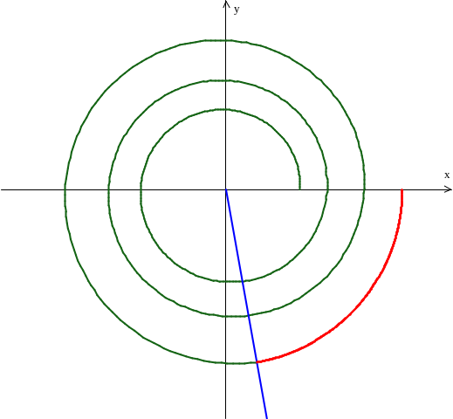
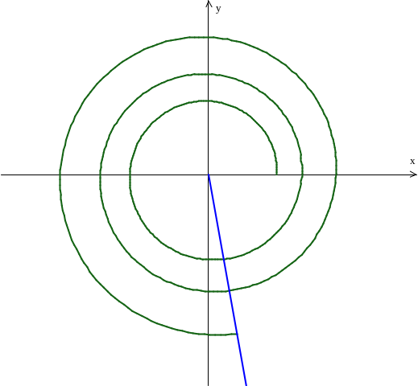


Draw the given angles on the x-y plane
reference angle =
Use your calculator and multiples of 360° to determine how many rotations

Slide 8
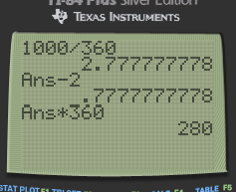
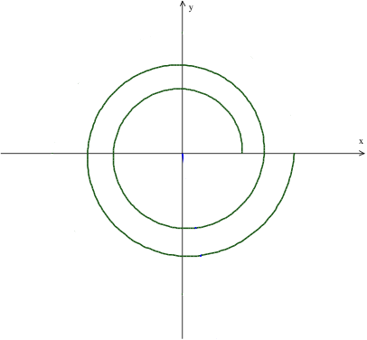
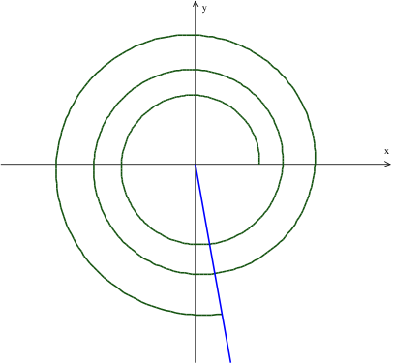
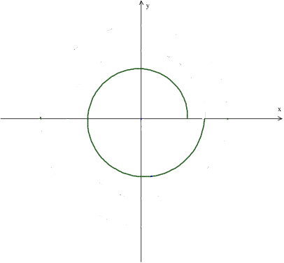
First divide the degree measure by 360 to determine the number of rotations
So the angle is two rotations clockwise plus some fraction of 360°
We subtract 2 so that we are just left with the decimal
Then we multiply that decimal by 360 to find the number of degrees in the partial rotation.
One Rotation
And we know that 280° is in Quadrant IV
Two Rotations
Then add 280°

Slide 9

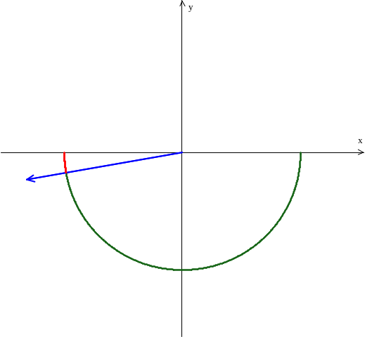
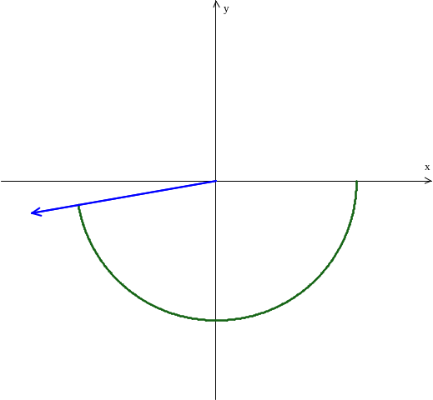


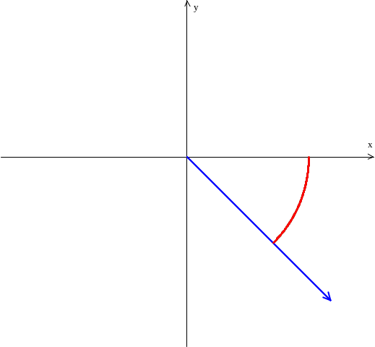
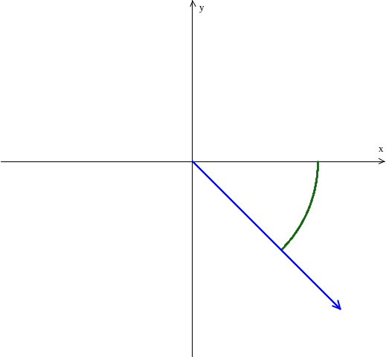
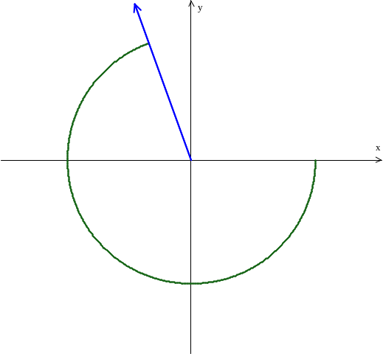
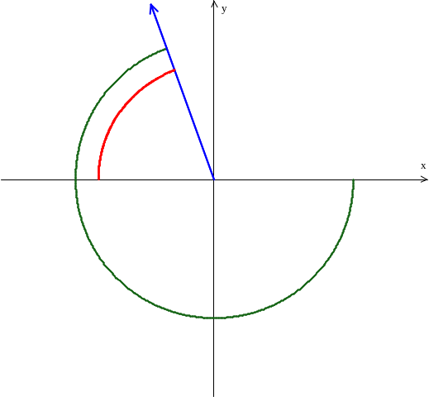
Draw the given angles on the x-y plane
reference angle =
reference angle =
Use your calculator and multiples of 360° to determine how many rotations
reference angle =
reference angle =

