Slide 1
A-6 Vectors
Standard A6a: Find and draw a resultant vector from other component vectors.
Standard A6b: Find the direction angle of a resultant vector from other component vectors.

Slide 2



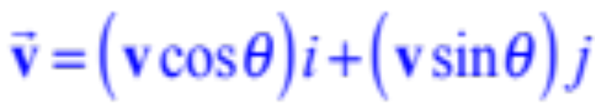
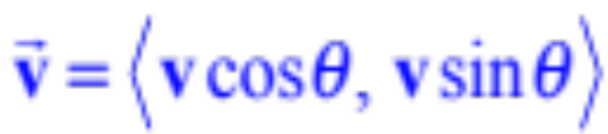
y
A vector is in standard position if the initial point is at the origin.
x
What if we only knew the length of the vector and the angle?
The component form of this vector is:
or
Before anyone panics, this is just SOHCAHTOA…
Just watch…

Slide 3

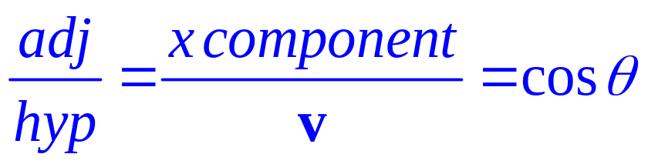


y
A vector is in standard position if the initial point is at the origin.
x
x component
x component
x component
Remember what this really means:
Think of it as a hypotenuse of the right triangle above because it’s the length of the vector
or
x component
x component

Slide 4
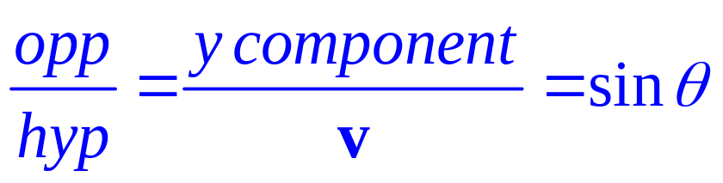
y
A vector is in standard position if the initial point is at the origin.
y component
x
y component
x component
y component
See? Just SOHCAHTOA
Remember what this really means:
Think of it as a hypotenuse of the right triangle above because it’s the length of the vector
or
x component
y component
x component
y component

Slide 5
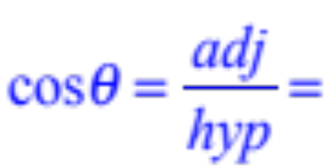
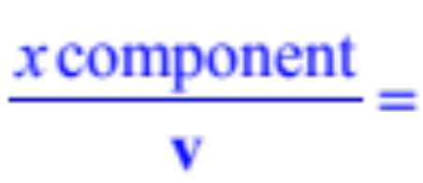
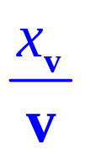
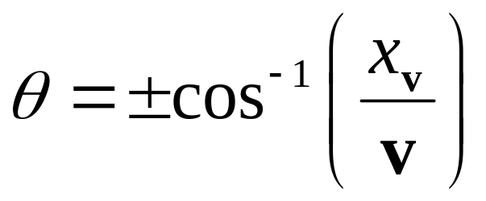
If it’s the angle that you need to find, then you need to know this:
y
y component
Remember that the magnitude and components form a right triangle
x
x component
The direction of a vector v is found this way:
The direction v is the angle θ
So this is just the x component divided by the magnitude
How would we determine which one?

Slide 6

x component
If it’s the angle that you need to find, then you need to know this:
y
y component
Remember that the magnitude and components form a right triangle
The direction angle here is negative because the y component is in a lower quadrant
The direction of a vector v is found this way:
The direction v is the angle θ
So this is just the x component divided by the magnitude
So the sign is determined by the sign of the y component

Slide 7
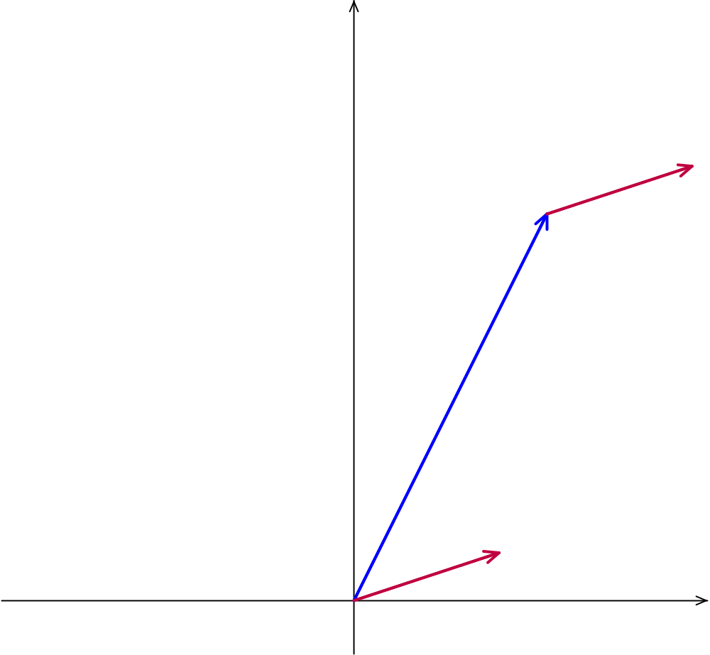
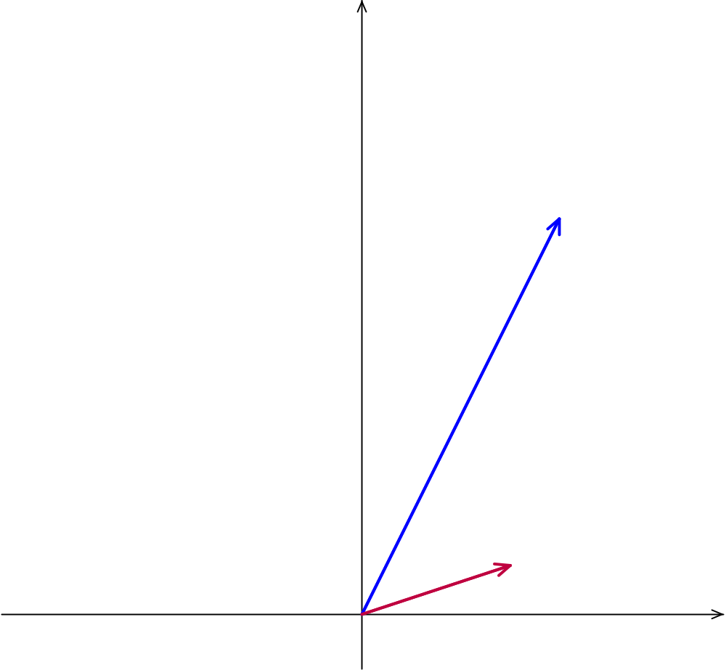
A boat is sailing at 20 mph with a direction of 52° north of east.
8
The current of the water at this time is 8 mph with a direction of 18° north of east
How does the current affect the speed and direction of the boat?
20
In other words find the vector that results from adding the first two vectors.
52°
8
18°

Slide 8
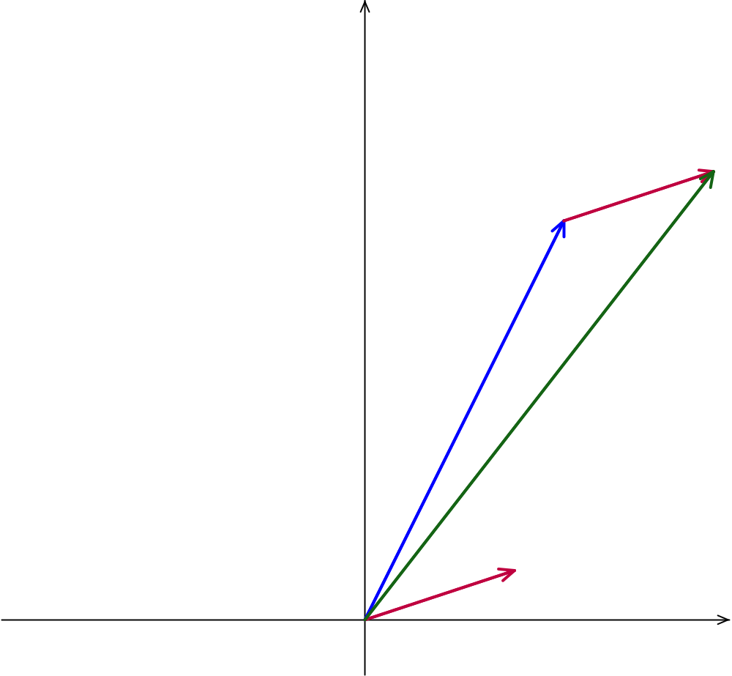
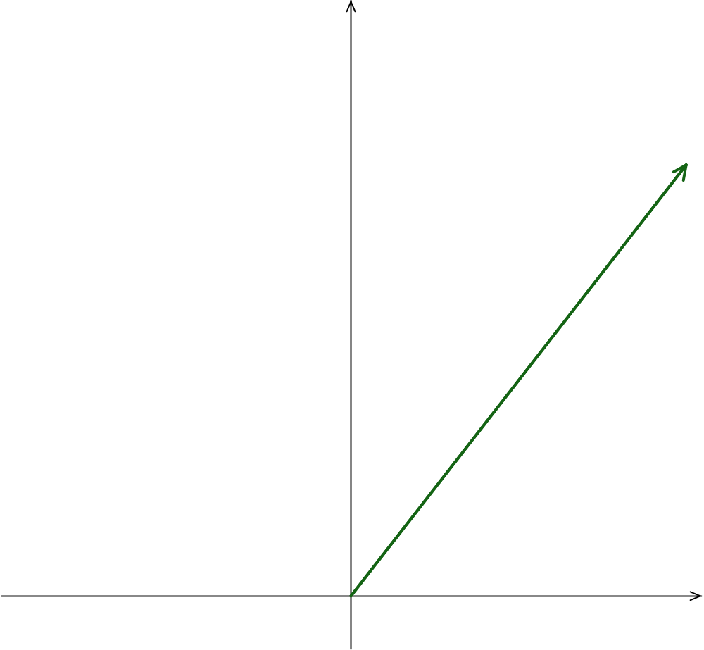
A boat is sailing at 20 mph with a direction of 52° north of east.
The current of the water at this time is 8 mph with a direction of 18° north of east
How does the current affect the speed and direction of the boat?
In other words find the vector that results from adding the first two vectors.
The sum of these two vectors will look like this.
In order to do add them we will have to break them into their x and y components one vector at a time.

Slide 9
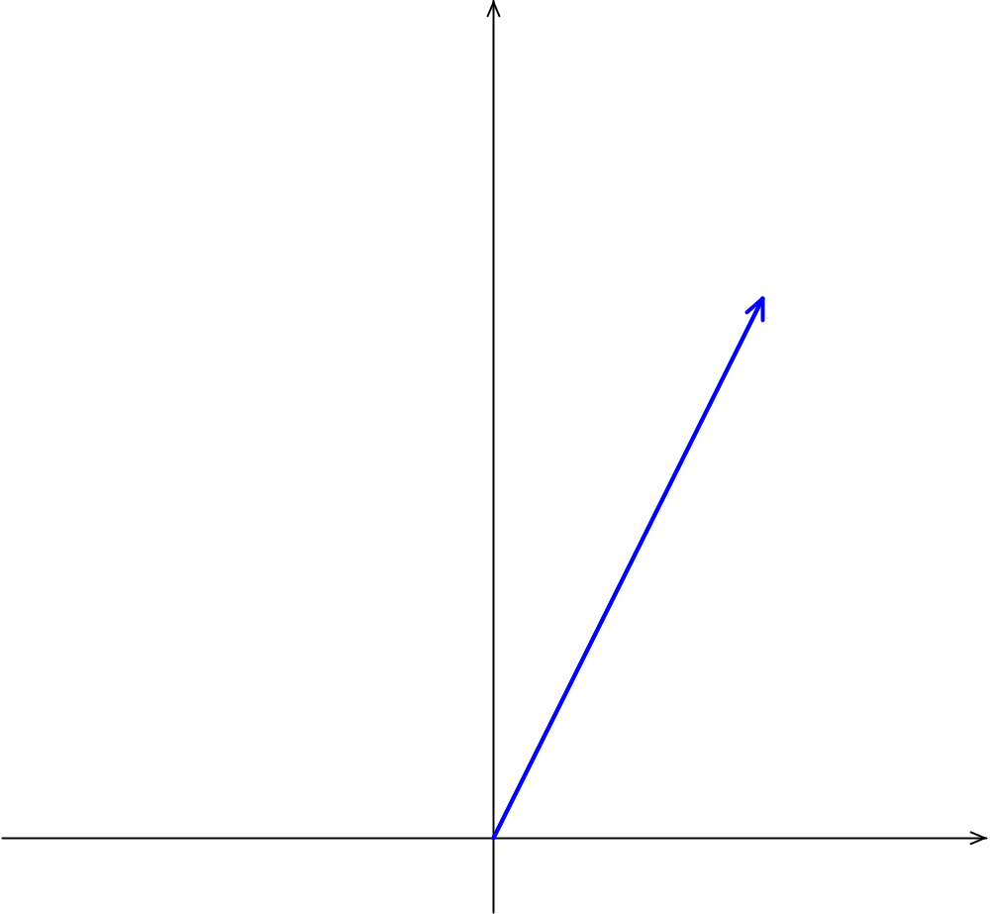
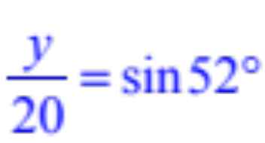



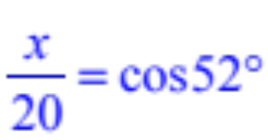


A boat is sailing at 20 mph with a direction of 52° north of east.
In order to add them we need to break each down into their x and y component form.
Notice the right triangle so let’s use SOHCAHTOA
20
y
52°
x
So the vector written in component form would look like this:

Slide 10
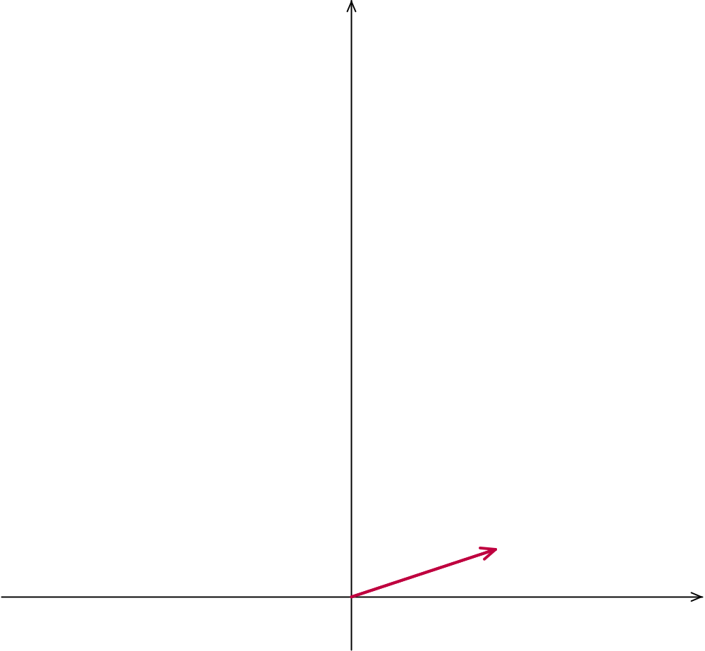
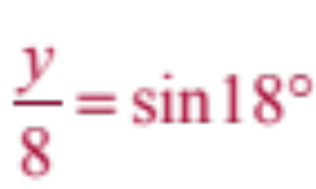



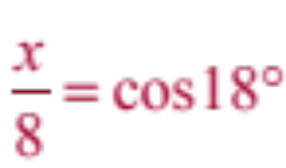


The current of the water at this time is 8 mph with a direction of 18° north of east
In order to add them we need to break each down into their x and y component form.
Notice the right triangle so let’s use SOHCAHTOA
8
y
18°
x
So the vector written in component form would look like this:

Slide 11
A boat is sailing at 20 mph with a direction of 52° north of east.
The current of the water at this time is 8 mph with a direction of 18° north of east
How does the current affect the speed and direction of the boat?
In other words find the vector that results from adding the first two vectors.
Now we just add their corresponding components

Slide 12
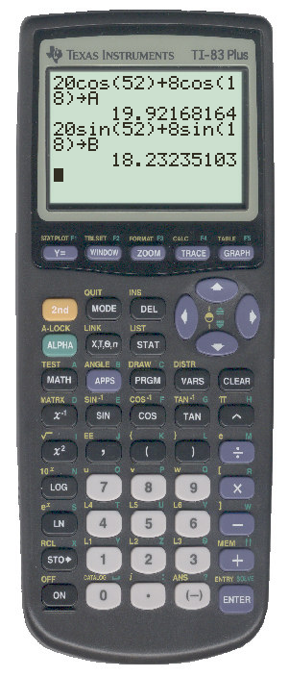

A boat is sailing at 20 mph with a direction of 52° north of east.
The current of the water at this time is 8 mph with a direction of 18° north of east
How does the current affect the speed and direction of the boat?
In other words find the vector that results from adding the first two vectors.
We’ll use the calculator to find the actual values
Note that we stored the values which will be explained shortly

Slide 13
We’ll use the calculator to find the actual values we don’t want to round anything until we have our final answer.
Enter your calculations then press this button followed by any letter.
The calculator stores the exact values here in A and B so we can use them later.

Slide 14
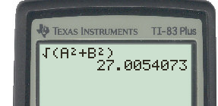
A boat is sailing at 20 mph with a direction of 52° north of east.
The current of the water at this time is 8 mph with a direction of 18° north of east
How does the current affect the speed and direction of the boat?
27.005
18.232
In other words find the vector that results from adding the first two vectors.
The speed is the length of this new vector which we can find using the Pythagorean Theorem and the stored values in the calculator.
19.922
27.005 mph
But what about it’s new direction?

Slide 15
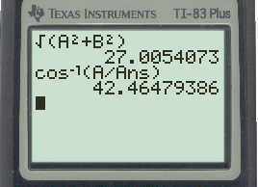
A boat is sailing at 20 mph with a direction of 52° north of east.
The current of the water at this time is 8 mph with a direction of 18° north of east
How does the current affect the speed and direction of the boat?
27.005
18.232
In other words find the vector that results from adding the first two vectors.
42.465°
Remembering the slide about inverse cosine, we just take the x component (adjacent) and divide it by the speed we just found (hypotenuse)
19.922
42.465°
‘Ans’ means enter the previously calculated answer which in this case is the hypotenuse.
And we know it’s positive because the y component is positive.
We can also see this because it is in the first quadrant.

Slide 16
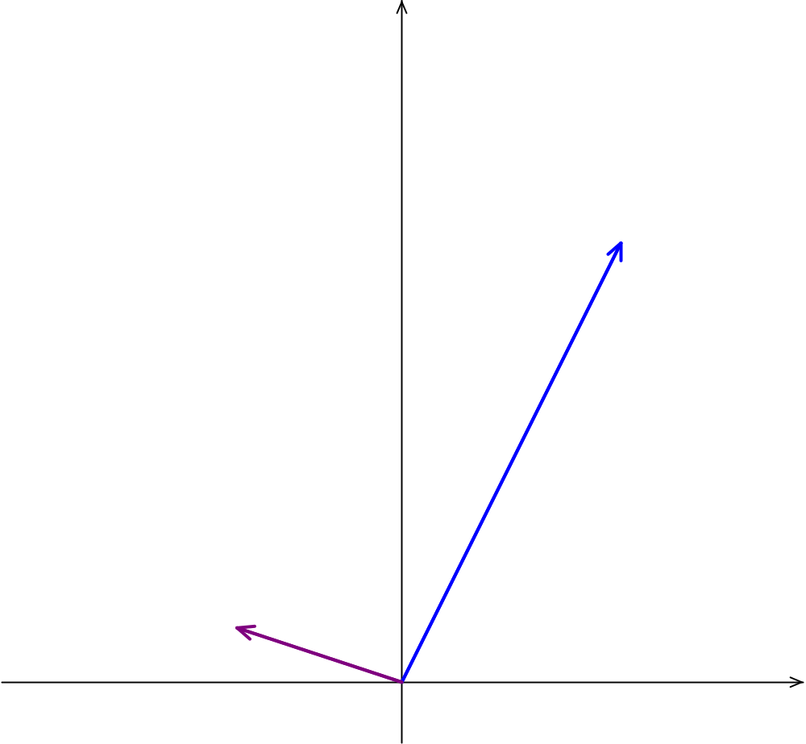

A boat is sailing at 20 mph with a direction of 52° north of east.
This time the current of the water is 8 mph with a direction of 18° north of west
How does the current affect the speed and direction of the boat?
20
This time we will have to do a little more work with the direction angles?
162°
52°
8
18°

Slide 17
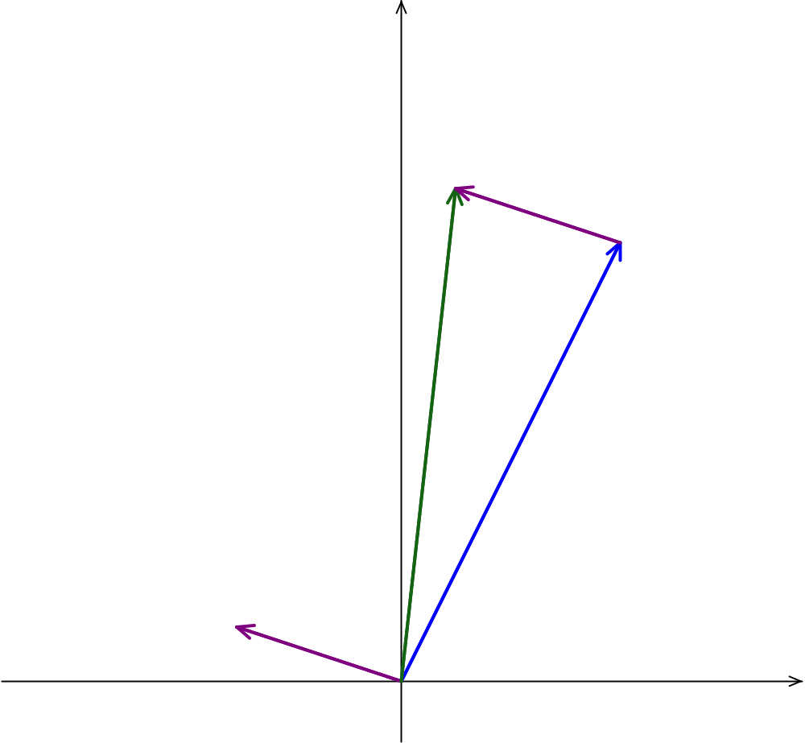
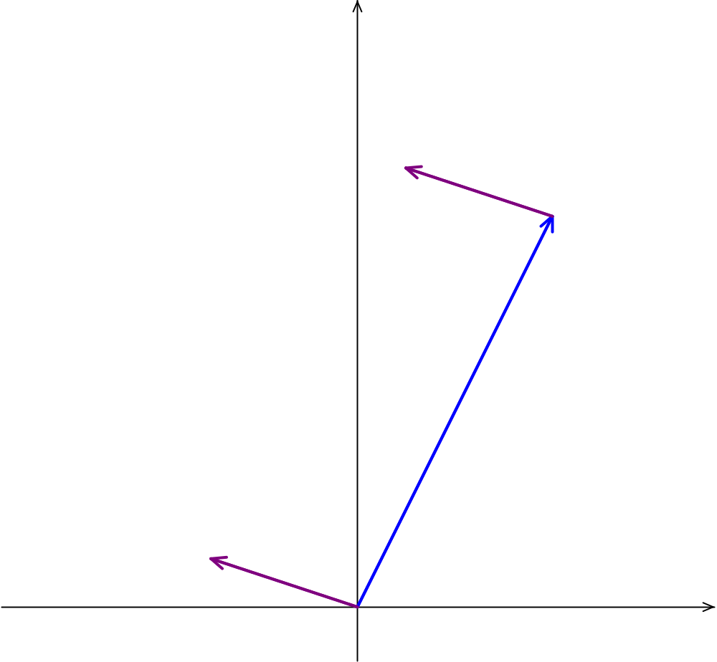
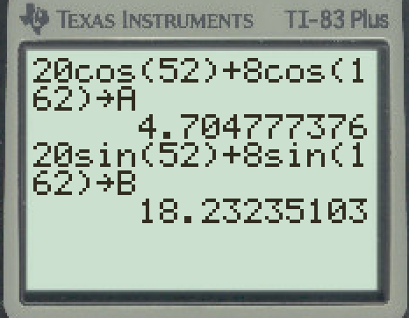

A boat is sailing at 20 mph with a direction of 52° north of east.
This time the current of the water is 8 mph with a direction of 18° north of west
How does the current affect the speed and direction of the boat?
20
This time we will have to do a little more work with the direction angles?
162°
52°
8
18°

Slide 18
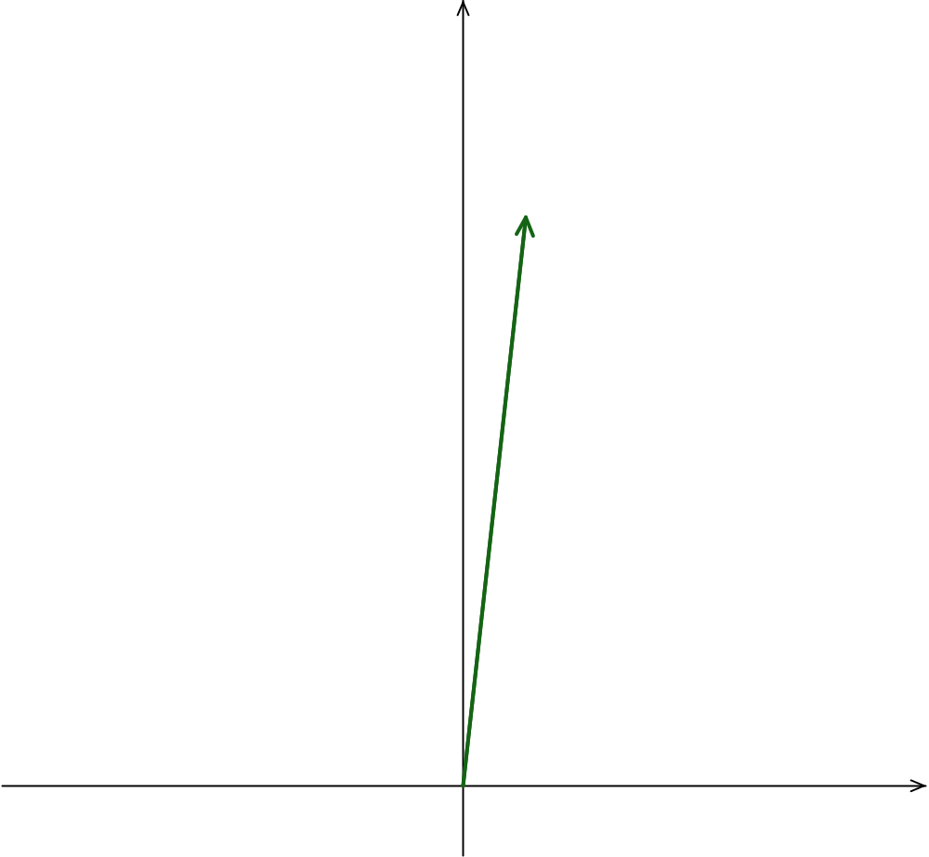
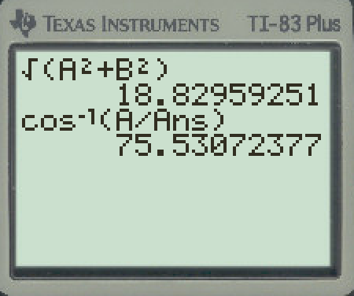
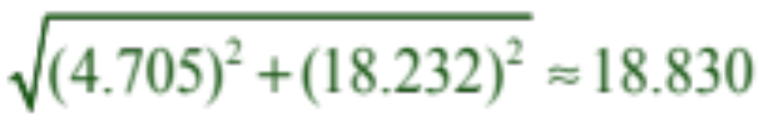
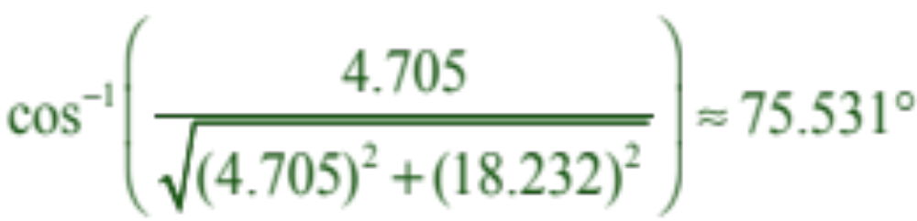
A boat is sailing at 20 mph with a direction of 52° north of east.
This time the current of the water is 8 mph with a direction of 18° north of west
18.830 mph
How does the current affect the speed and direction of the boat?
This time we will have to do a little more work with the direction angles?
75.531°

