Slide 1
Rational Inequalities
Standard 4f: Use sign patterns to solve rational inequalities

Slide 2
We’ve found a number of traits already in Standards 4a, 4b, 4d, and 4e
Now we are going to use inequalities to determine values of y
Solving a Rational Inequality
Determine when y = 0 or undefined
Make a sign pattern to determine the values of x for which y is positive, negative, zero, or undefined
Write the interval to include the zeros only if they were included in the original inequality (in other words, if the original inequality used > 0 or < 0)

Slide 3
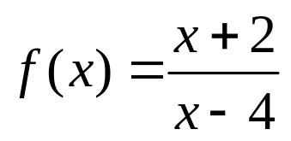



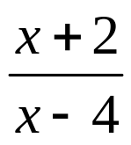


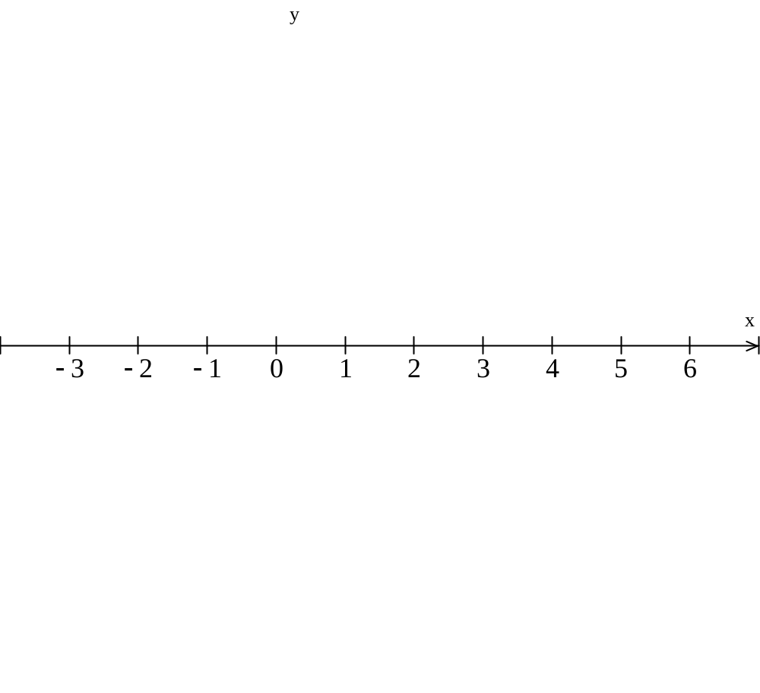


Numerator = 0
Find the values of x for which
So we start by finding the values of x for which
Denominator = 0
= 0 or undefined
Numerator = 0 or Denominator = 0
+
0
–
undef
+
or

Slide 4
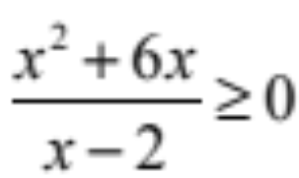


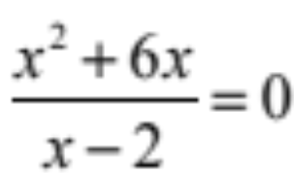
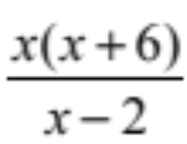




Find the values of x for which
Numerator = 0
Denominator = 0
= 0 or undefined
Numerator = 0 or Denominator = 0
–
0
+
0
–
undef
+

Slide 5
See the Rational Inequalities Screencast and pdf for more examples

